Slide 1
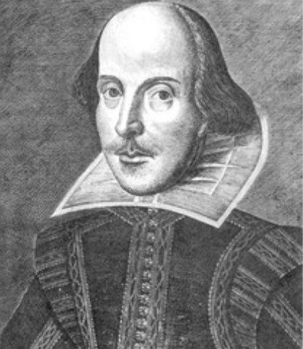
Verona Heritage Minutes Assignment

Slide 2
Canadian Heritage Minutes
The Heritage Minutes are a collection of bilingual Canadian 60-second short films, each depicting a significant person, event or story in Canadian history. First released in 1991, they have been shown on television, in cinemas and online, and have become a part of Canadian culture.
As of 2018, there are 86 episodes. They are owned and distributed by the Canadian Broadcast Association and } Historica Canada.

Slide 3
The Goals of these Episodes were to…
Intrigue us with Canada’s heritage
Be producible within resources
Be truthful within the bounds of dramatic license
Reflect and celebrate Canadian social and cultural values: tolerance, fairness, courage, tenacity, resourcefulness, inventiveness
Reveal origins
Surprise, provoke reflection, re-examination, raise questions.

Slide 4
Here are a few Examples
These Youtube clips are owned and distributed by Historica Canada.

Slide 5
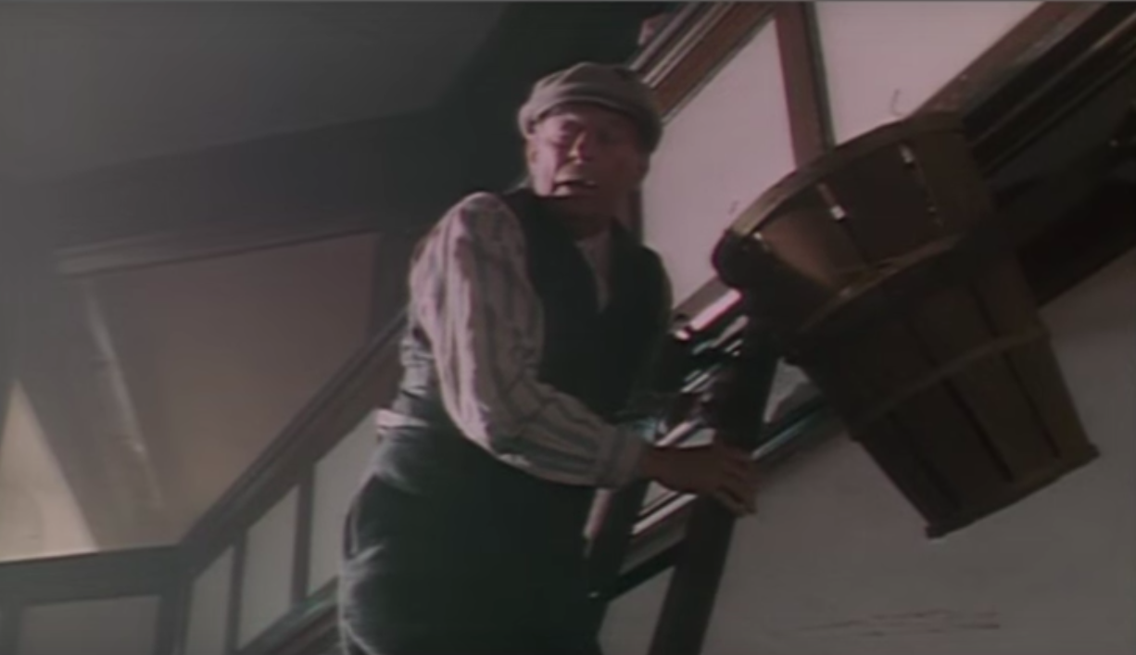
https://www.youtube.com/watch?v=xiJJIacdF-E

Slide 6
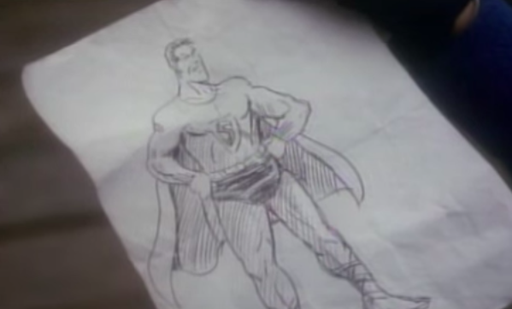
https://www.youtube.com/watch?v=ScFwRoLhR2s

Slide 7
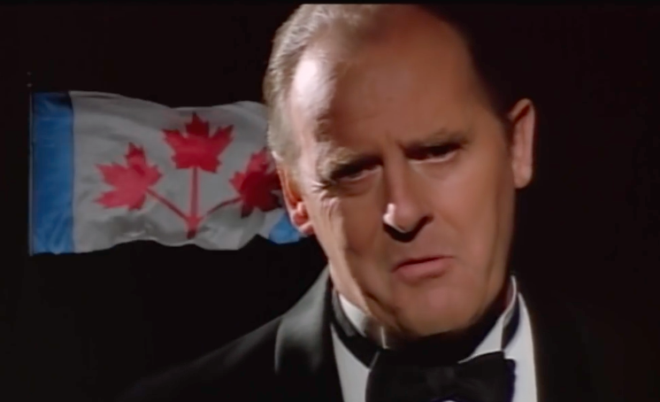
https://www.youtube.com/watch?v=ikY7bMDVQTg

Slide 8
Your Assignment…

Slide 9
What Caused the Feud Between the Montagues and Capulets?
In groups of 3-4, you will use your imagination and clues from the play to come up with a story for what happened between the Montagues and the Capulets.

Slide 10
Things to Consider…
How old is the feud? (Prologue).
What characters are the most passionate about the feud?
What characters seem to be less interested in the feud?
How do certain non- Montagues and Capulets respond to the feud?

Slide 11
Requirements
The video must be 80 seconds to 2 minutes
Every group member must speak on screen.

Slide 12
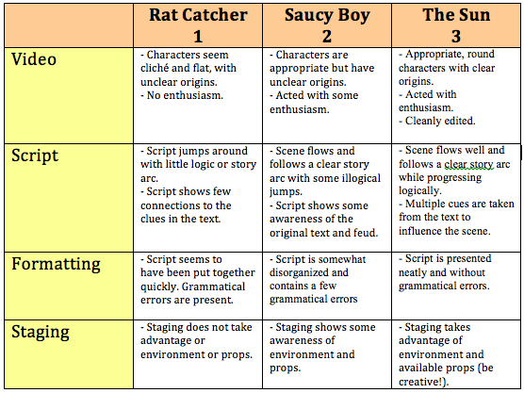
The Rubric
/12

