Slide 1
Battle of Jutland
Also Called Battle of the Skagerrak

Slide 2
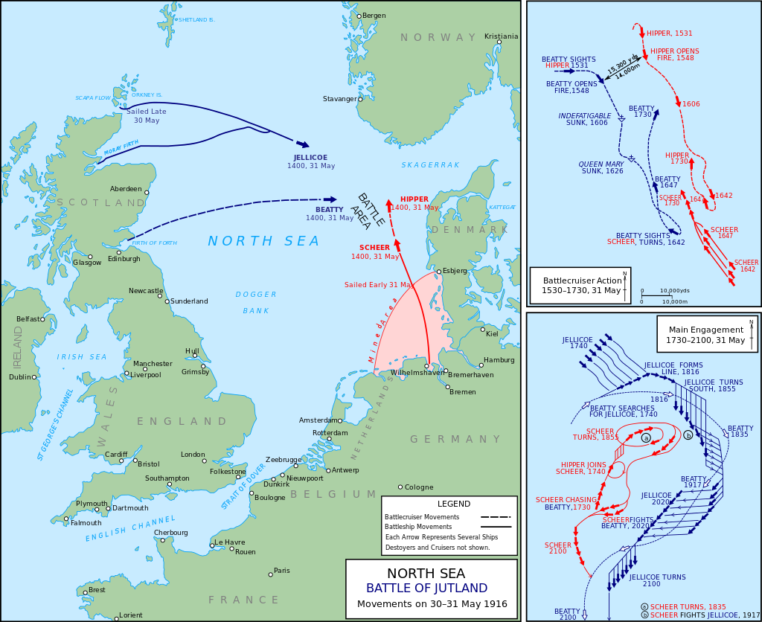
Location Of The Battle
Coast of Denmark’s Jutland Peninsula.

Slide 3
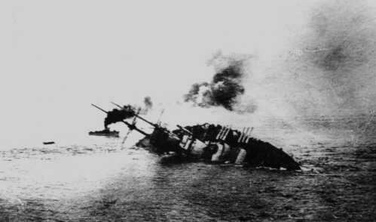
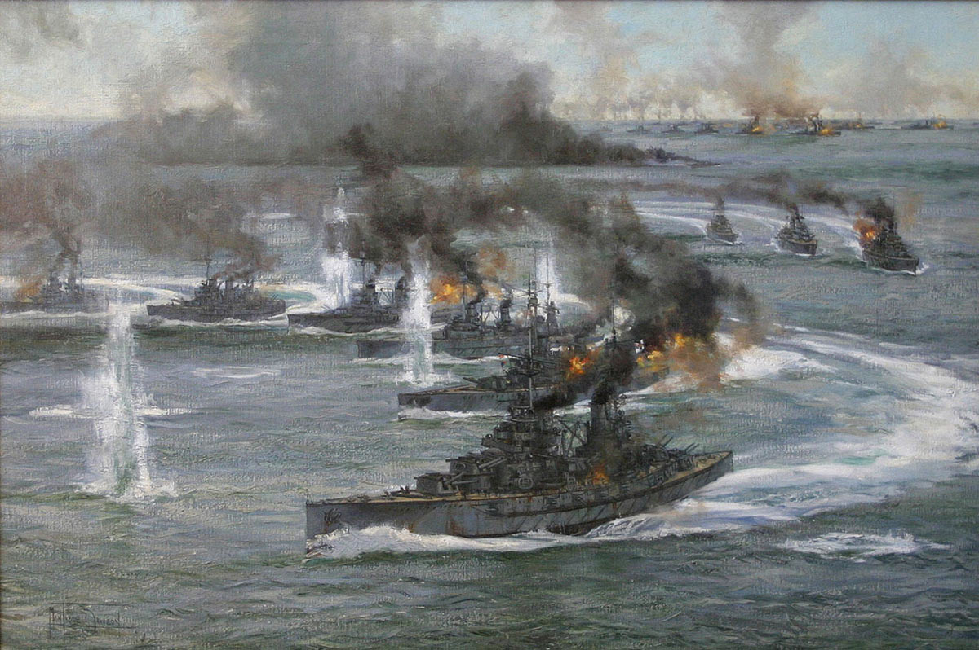
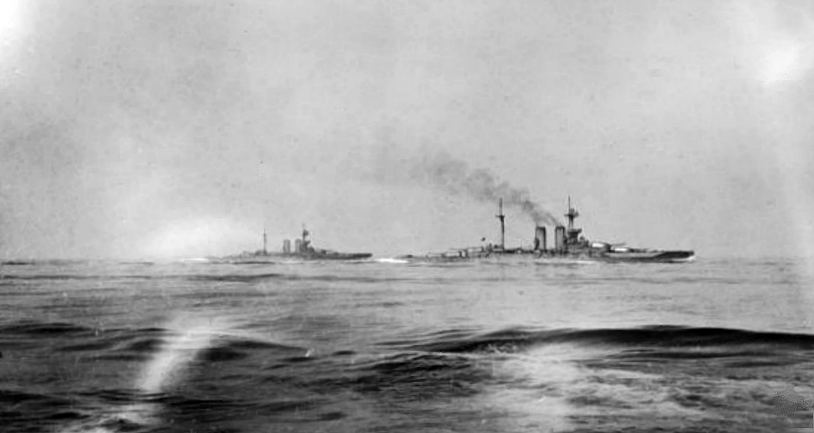
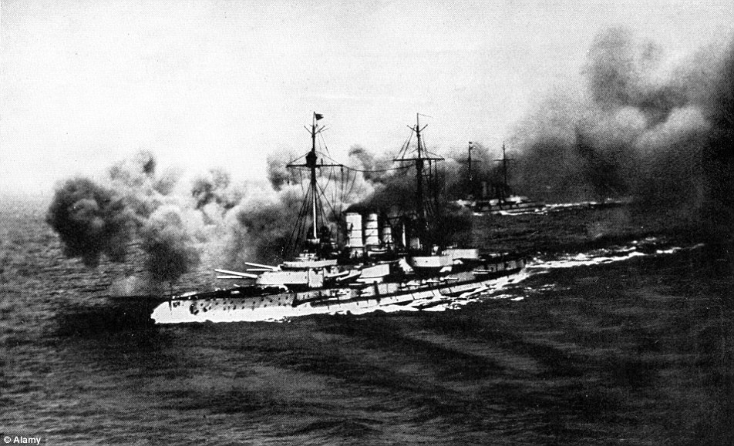
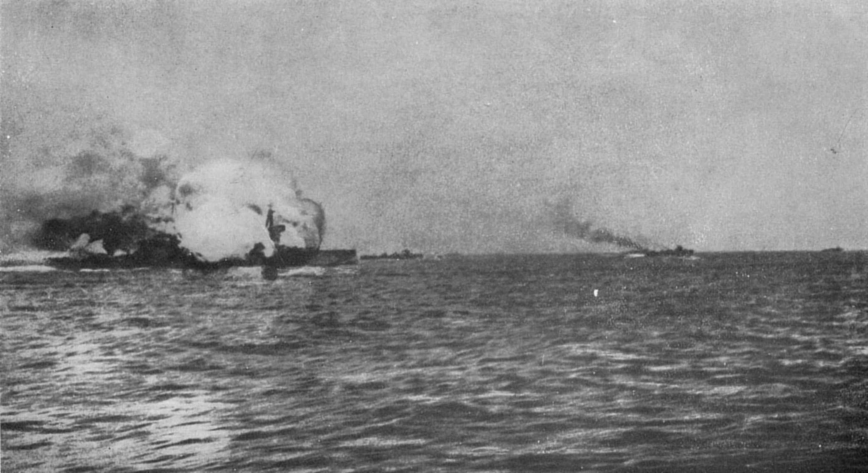
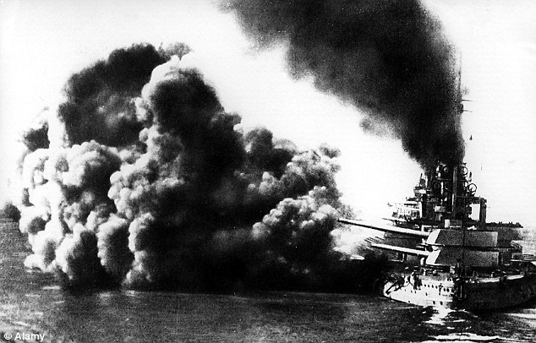

Slide 4
Outline of the Battle Events
The battle started on May 31 to June 1 1916 in the North Sea, near the coast of Denmark's Jutland Peninsula.
On May 31st the British spotted the German warships and began a gun battle lasted for 55 minutes until the rest of their fleet could join. Two British battlecruisers were destroyed, killing over 2000 sailors.
The two fleets continued to engage each other throughout the late evening and the early morning of June 1.
Jellicoe the commander of the British fleet maneuvered 96 of the British ships into a V-shape surrounding 59 German ships. Hipper the German commander’s flagship, Lutzow, was disabled by 24 direct hits but was able to sink the British battle cruiser Invincible before it sank
The British fleet executed a previously planned withdrawal under cover of darkness at the German port of Wilhelmshaven ending the battle on the evening of June 1.

Slide 5
Significant Events
Originally 19 U-boat submarines were to position themselves for a raid on the North Sea coastal city but because of bad weather they called off the raid and sent the fleet north to attack the allies
At 4:48 p.m artillery fire was exchanged at 15,00 yard between British and German Scout Ships
At 7:15 p.m Admiral John Jellicoe cut off the Germans from their base and exchanged fire forcing the German short to retreat

Slide 6
Reason For success
The British were able to keep control of the North Sea
Even though the British had lost more ships the Grand Fleet was so large that the lost did not affect them as much as it did the Germans
The british had broke the Germans signal codes

Slide 7
Impact on WWI
Britain had established a trade blockade through the north sea cutting off germany and its allies
The Germans navy was heavily outnumbered compared to the the british

Slide 8
Highlights of Canada’s Contributions
Most Canadian Sailors were hired by the British Navy.
During 1914 Canada only had 350 Sailors recorded as hired and only had two ships in use.
Canada lost one of their men during the battle, Engineer-Lieutenant Stanley N. De Quetteville. He is the only man listed in Canada’s casualties.
Canada was sent to assist and protect the British. There were about 3,000 Canadian’s in this naval battle.
Over 100,000 people took part during the Battle of Jutland.
The battle lasted 12 hours and was the largest battle on water ever recorded.

Slide 9
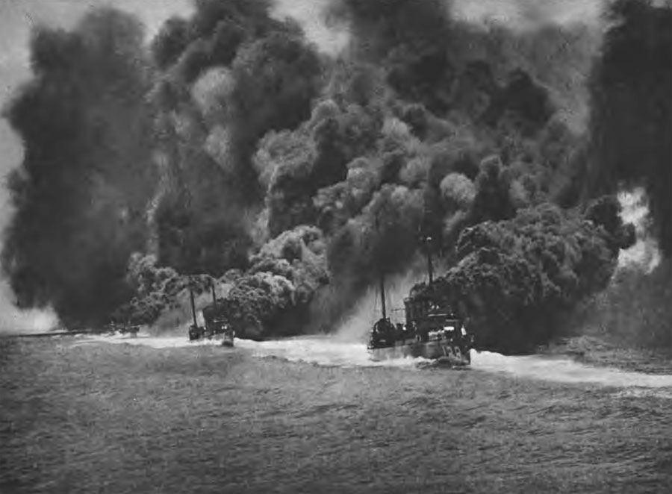
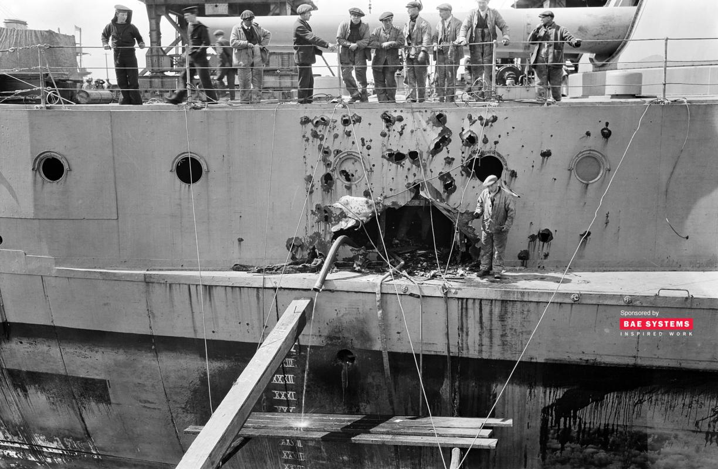
The Costs
Canada lost one man during the entire Battle of Jutland.
Canadian’s worked with British on their boats. Unfortunately, we lost 8 destroyers ships, 3 Armoured Cruisers, and 3 battlecruisers.
We also lost just over 6,000 of our British allies.

Slide 10
Video!

Slide 11
Resources
http://www.battle-of-jutland.com/jutland-gains-losses.htm
https://greatwarcentre.com/tag/battle-of-jutland/
http://www.history.com/topics/world-war-i/battle-of-jutland

