Slide 1
Examples of Bias
Bias: prejudice in favour of or against something based on personal beliefs, religion, politics, history etc. Everyone has bias.
*** The very nature of deciding that something is important enough to write about is bias.
Any time an individual tells a story, bias will be present. This is especially true in autobiographies.
As human beings, we remember situations in specific ways. Our opinions on events are made bias by the emotions that we felt in the moment (good or bad).

Slide 2
What responsibilities does an autobiographer have in depicting their life story?
What are their responsibilities to looking at their experience from multiple perspectives?
What responsibilities do they have in depicting real life individuals mentioned in their story?

Slide 3
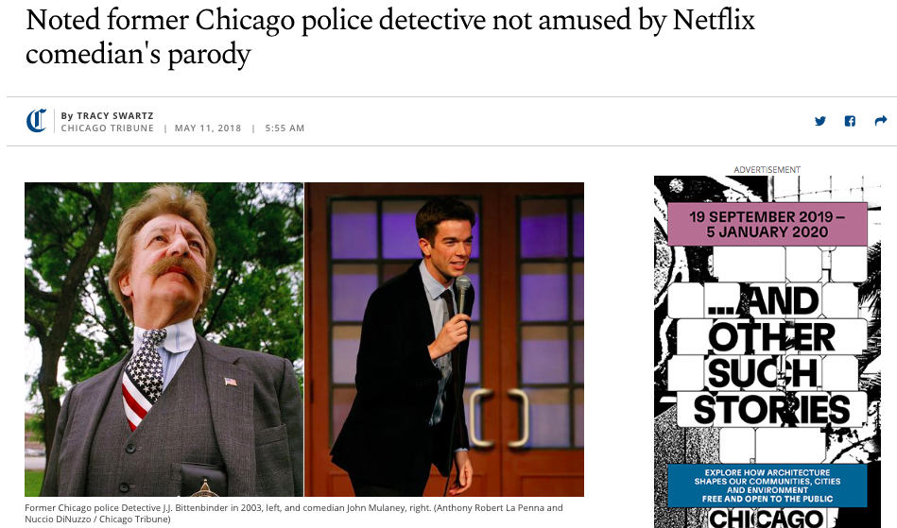
https://www.youtube.com/watch?v=2UjR7ViU_yo

Slide 4
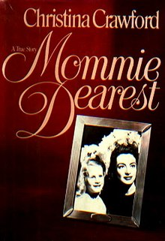
a memoir and exposé written by Christina Crawford, the adopted daughter of actress Joan Crawford.
Published in 1978, it described the author's upbringing by an unbalanced alcoholic mother, whom she judged unfit to raise children. The book attracted much controversy regarding child abuse and child trafficking, with many family friends denouncing it as fiction, but others claiming that it was a broadly accurate, if exaggerated, account of Christina’s troubled childhood.
It was turned into a 1981 film starring Faye Dunaway.

Slide 5
But What About Movies?

Slide 6
Trailer
https://www.youtube.com/watch?v=MBZ-POVsrlI
Good Bad Flicks
https://www.youtube.com/watch?v=zJtS3ACtbuU

Slide 7
“The True Story Of” vs “Based On” vs “Inspired By”
We all have clear expectations regarding biographies and auto biographies, but what about the stories that fall somewhere in between?
The true story of…
Based on a true story…
Inspired by a true story

Slide 8
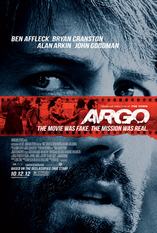
BASED ON A TRUE STORY
https://www.youtube.com/watch?v=w918Eh3fij0

Slide 9
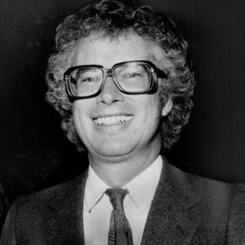
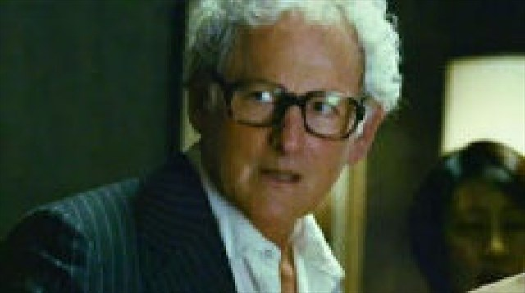
Ben Affleck's Argo was huge in 2012, winning three Academy Awards, including Best Picture.
Alas, it's also fairly factually inaccurate, especially the way it minimizes Canada's role in the whole hostage-extraction plan that drives the story.
President Jimmy Carter himself called out Argo for making stuff up, saying "90 percent of the contributions to the ideas and consummation of the plan were Canadian.
The movie gives almost full credit to the American CIA." Carter specifically points out Ken Taylor (played by Victor Garber in the film) as the person he identifies as the main hero.
On a scale of 1-10 how morally questionable was it for Argo to take the heroic actions of one man and give them to another?

Slide 10
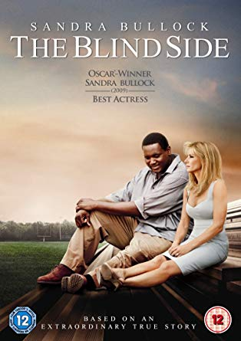
BASED ON THE ENCREDIBLE TRUE STORY
https://www.youtube.com/watch?v=gvqj_Tk_kuM

Slide 11
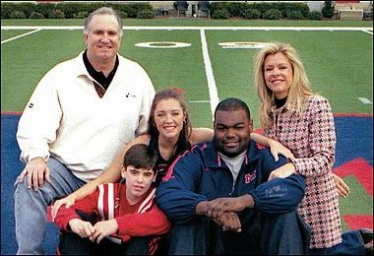
In 2009, The Blind Side showed how Michael Oher was adopted by a wealthy family and overcame the odds to become an NFL star.
It earned Sandra Bullock an Academy Award—and it also Inspired Oher to write a book setting the record straight. For starters, Oher said adopted mom Leigh Anne Tuhoy didn't actually have to teach him how to play football.
"No, that's not me at all! I've been studying—really studying—the game since I was a kid! I felt like it portrayed me as dumb instead of as a kid who had never had consistent academic instruction and ended up thriving once he got it.
Quinton Aaron did a great job acting the part, but I could not figure out why the director chose to show me as someone who had to be taught the game of football.”
On a scale of 1-10 how morally questionable was it for this film to over exaggerate Anne’s involvement in Michael’s success?

Slide 12
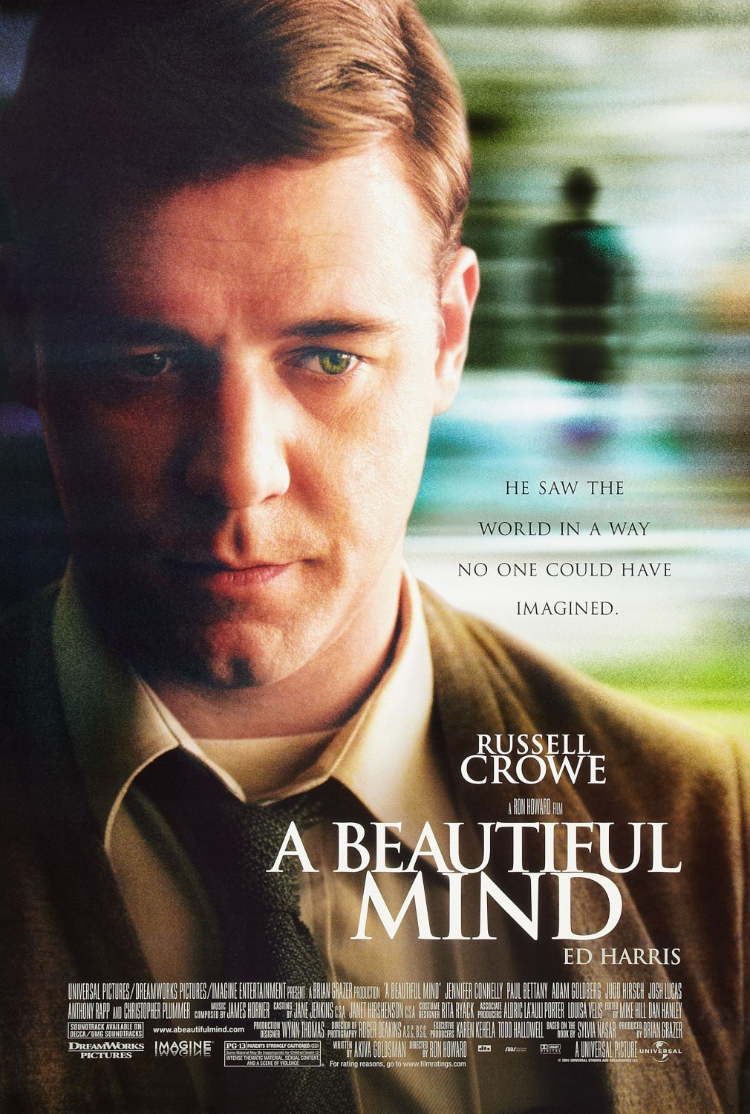
https://www.youtube.com/watch?v=YWwAOutgWBQ

Slide 13
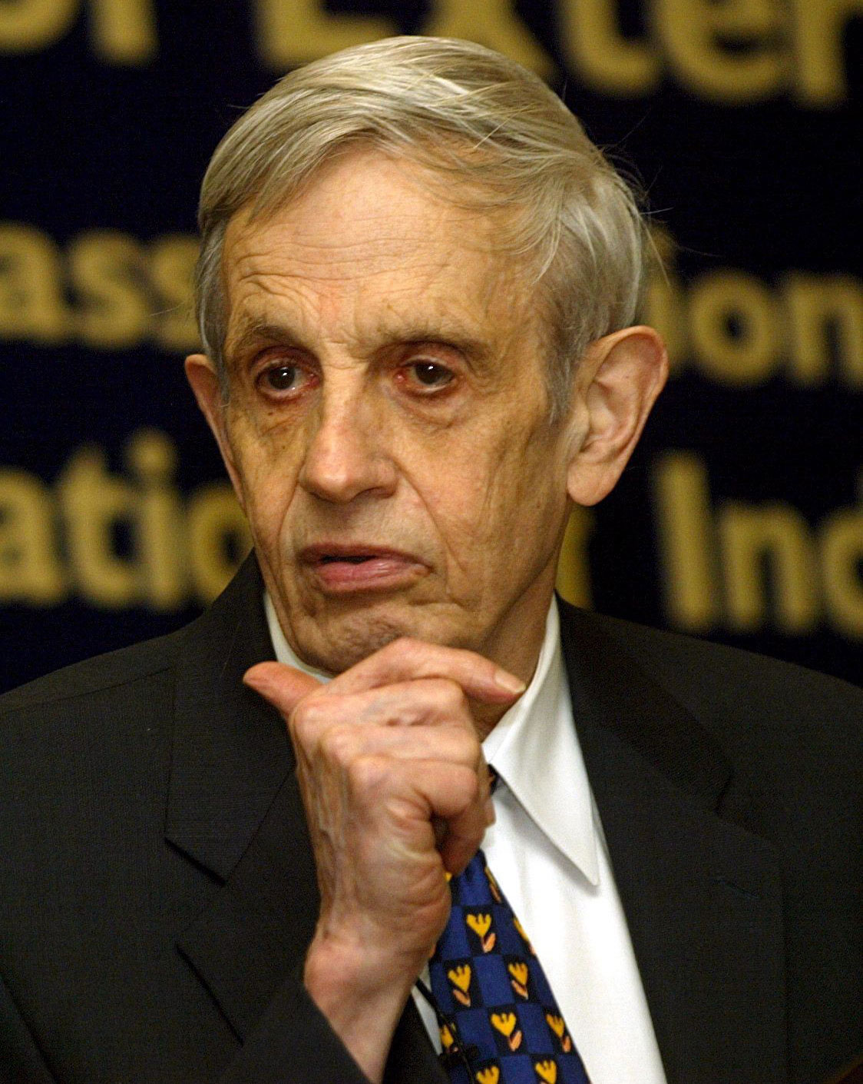
This Russell Crowe-led hit took an uplifting look into the life story of economics Nobel Laureate John Nash—one that was unfortunately highly fictionalized. For starters, the real-life Nash never joined Wheeler Laboratory at MIT, because it doesn't exist (he did work at MIT).
The movie shows him as a dad, and he did become a father in real life…of a child out of wedlock, whose mother he abandoned. It also ignores proven instances of domestic abuse in the relationship.
Nash also never actually gave an acceptance speech for his Nobel prize.
On a scale of 1-10 how morally questionable was it for this film to fabricate information to cover up actions making the protagonist less likable?

Slide 14
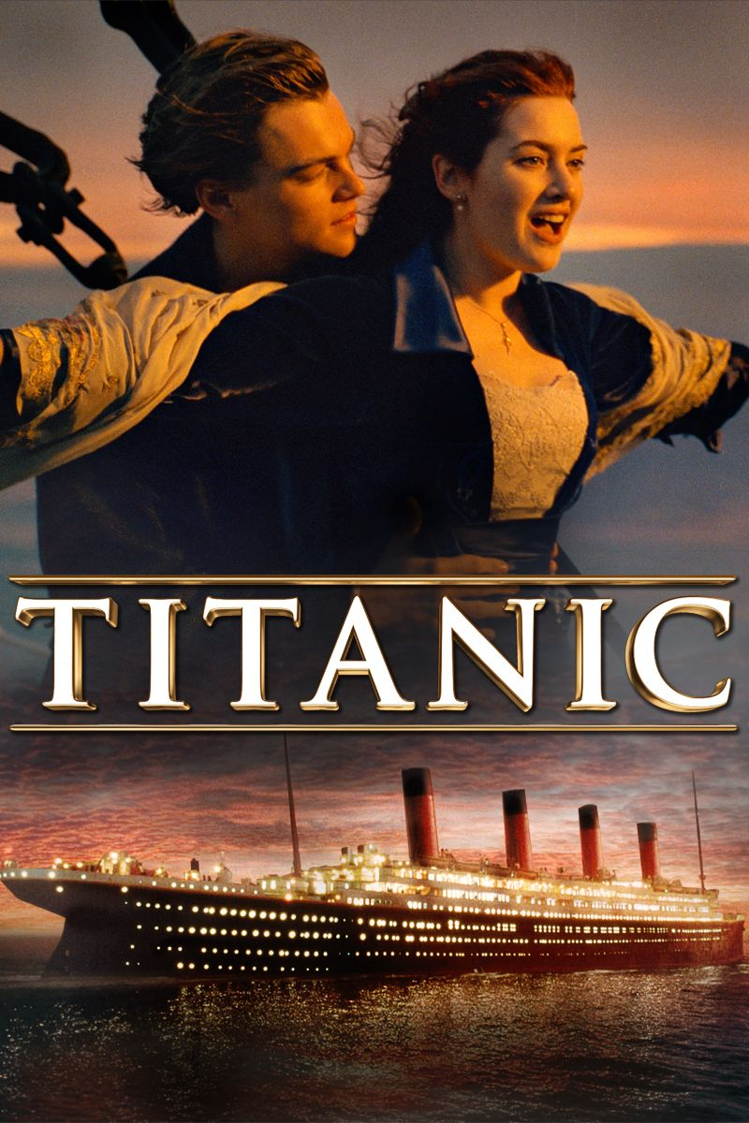
Titanic makes no effort to make this film based on the 1912 tragedy follow actual facts (nor convince the audience that it has done so).
While the sequence of events regarding the sinking itself are accurate. Rose and Jack never existed.
The film does however, use real ship personal and historical figures as secondary characters (creating fictional stories for real life people).
https://www.youtube.com/watch?v=jUm88F3MEbQ

Slide 15
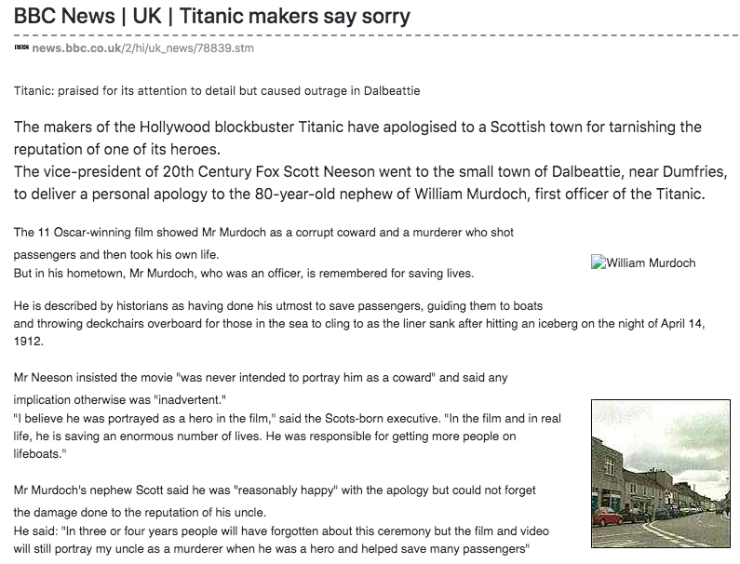

Slide 16
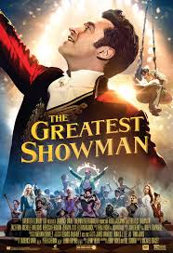
TRAILER
https://www.youtube.com/watch?v=jr9QtXwC9vc

Slide 17
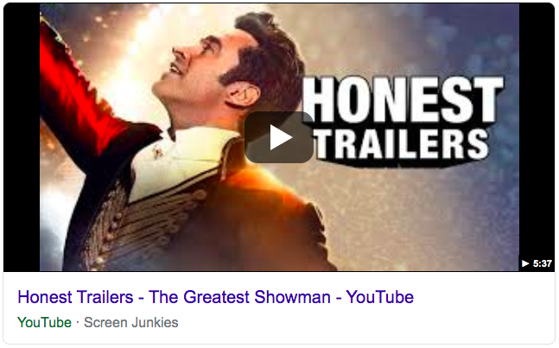
https://www.youtube.com/watch?v=CaE0JD1X12g

