Slide 1
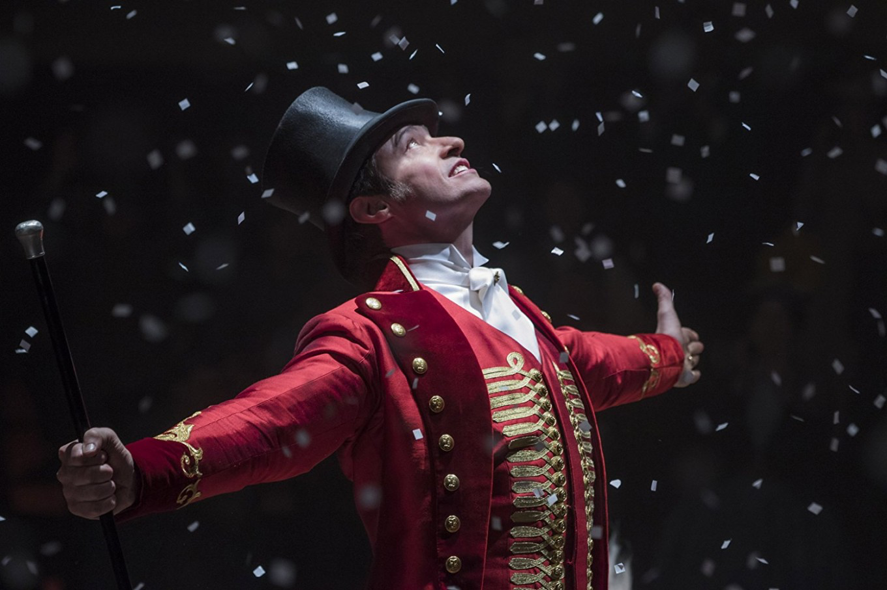
The Ethics of “Non Fiction” Literature
Biographies, Autobiographies Narrative Journalism

Slide 3
What do people expect when they read a biography or autobiography?
Biography:
An account of an individual’s live, written by someone else.
(Primary or secondary resource).
Auto-biography:
An account of someone’s life, written by themselves.
(Primary resource).
A well rounded account of someone’s life or specific events.
A reader will expect bias in an autobiography (since it’s first person); however, biographies should be looked at from an unbiased eye with multiple perspectives.
A clear narrative plotline.
Things CAN be omitted, but not if those things are essential to the plot or an honest depiction of the subject.

Slide 4
Literary Forgery
mystification, literary fraud or literary hoax) is
writing, such as a manuscript or a literary work, which is either deliberately misattributed to a historical or invented author
a purported memoir or other presumably nonfictional writing deceptively presented as true when, in fact, it presents untrue or imaginary information.
* Literary forgery is DIFFERENT than fictional first person narrative, mocumentaries etc.

Slide 5
Examples
Margaret B. Jones: the author's story about being a young American foster girl who was raised in a gangland culture in Los Angeles involving drugs, forced sex and criminality.
The author, real name Margaret Seltzer, was exposed as a fraud by her elder sister: in reality, she has lived a middle-class life without trauma, and received a good education.
Danny Santiago: author of Famous All Over Town, published a novel in which he depicts life through the eyes of a young Hispanic boy growing up in East Los Angeles. The novel won the Rosenthal Award for Literary Achievement in 1984.
Suspicion arose about the true identity of Danny Santiago when the author refused to supply a biographical sketch for editors at Simon & Schuster who wanted to submit the book for a Pulitzer Prize.[ An investigation revealed that the writer was actually Daniel James, a middle- to older-aged Caucasian male writing from the standpoint of a young Latino American boy. He received criticism from the literary community, and gave up writing for good.
James Frey: another author chastised for forging his memoir, published A Million Little Pieces, a memoir about his struggle with drug addiction and his journey through the inner working of the legal system and rehabilitation.
The truth about his "imagined escapades" eventually came to light when his close family and friends revealed that he had actually never been a drug addict or incarcerated. Frey eventually faced more than 10 class action lawsuits, including negligence, false advertising, and breach of contract. At the heart of each suit was an allegation of fraud.

Slide 6
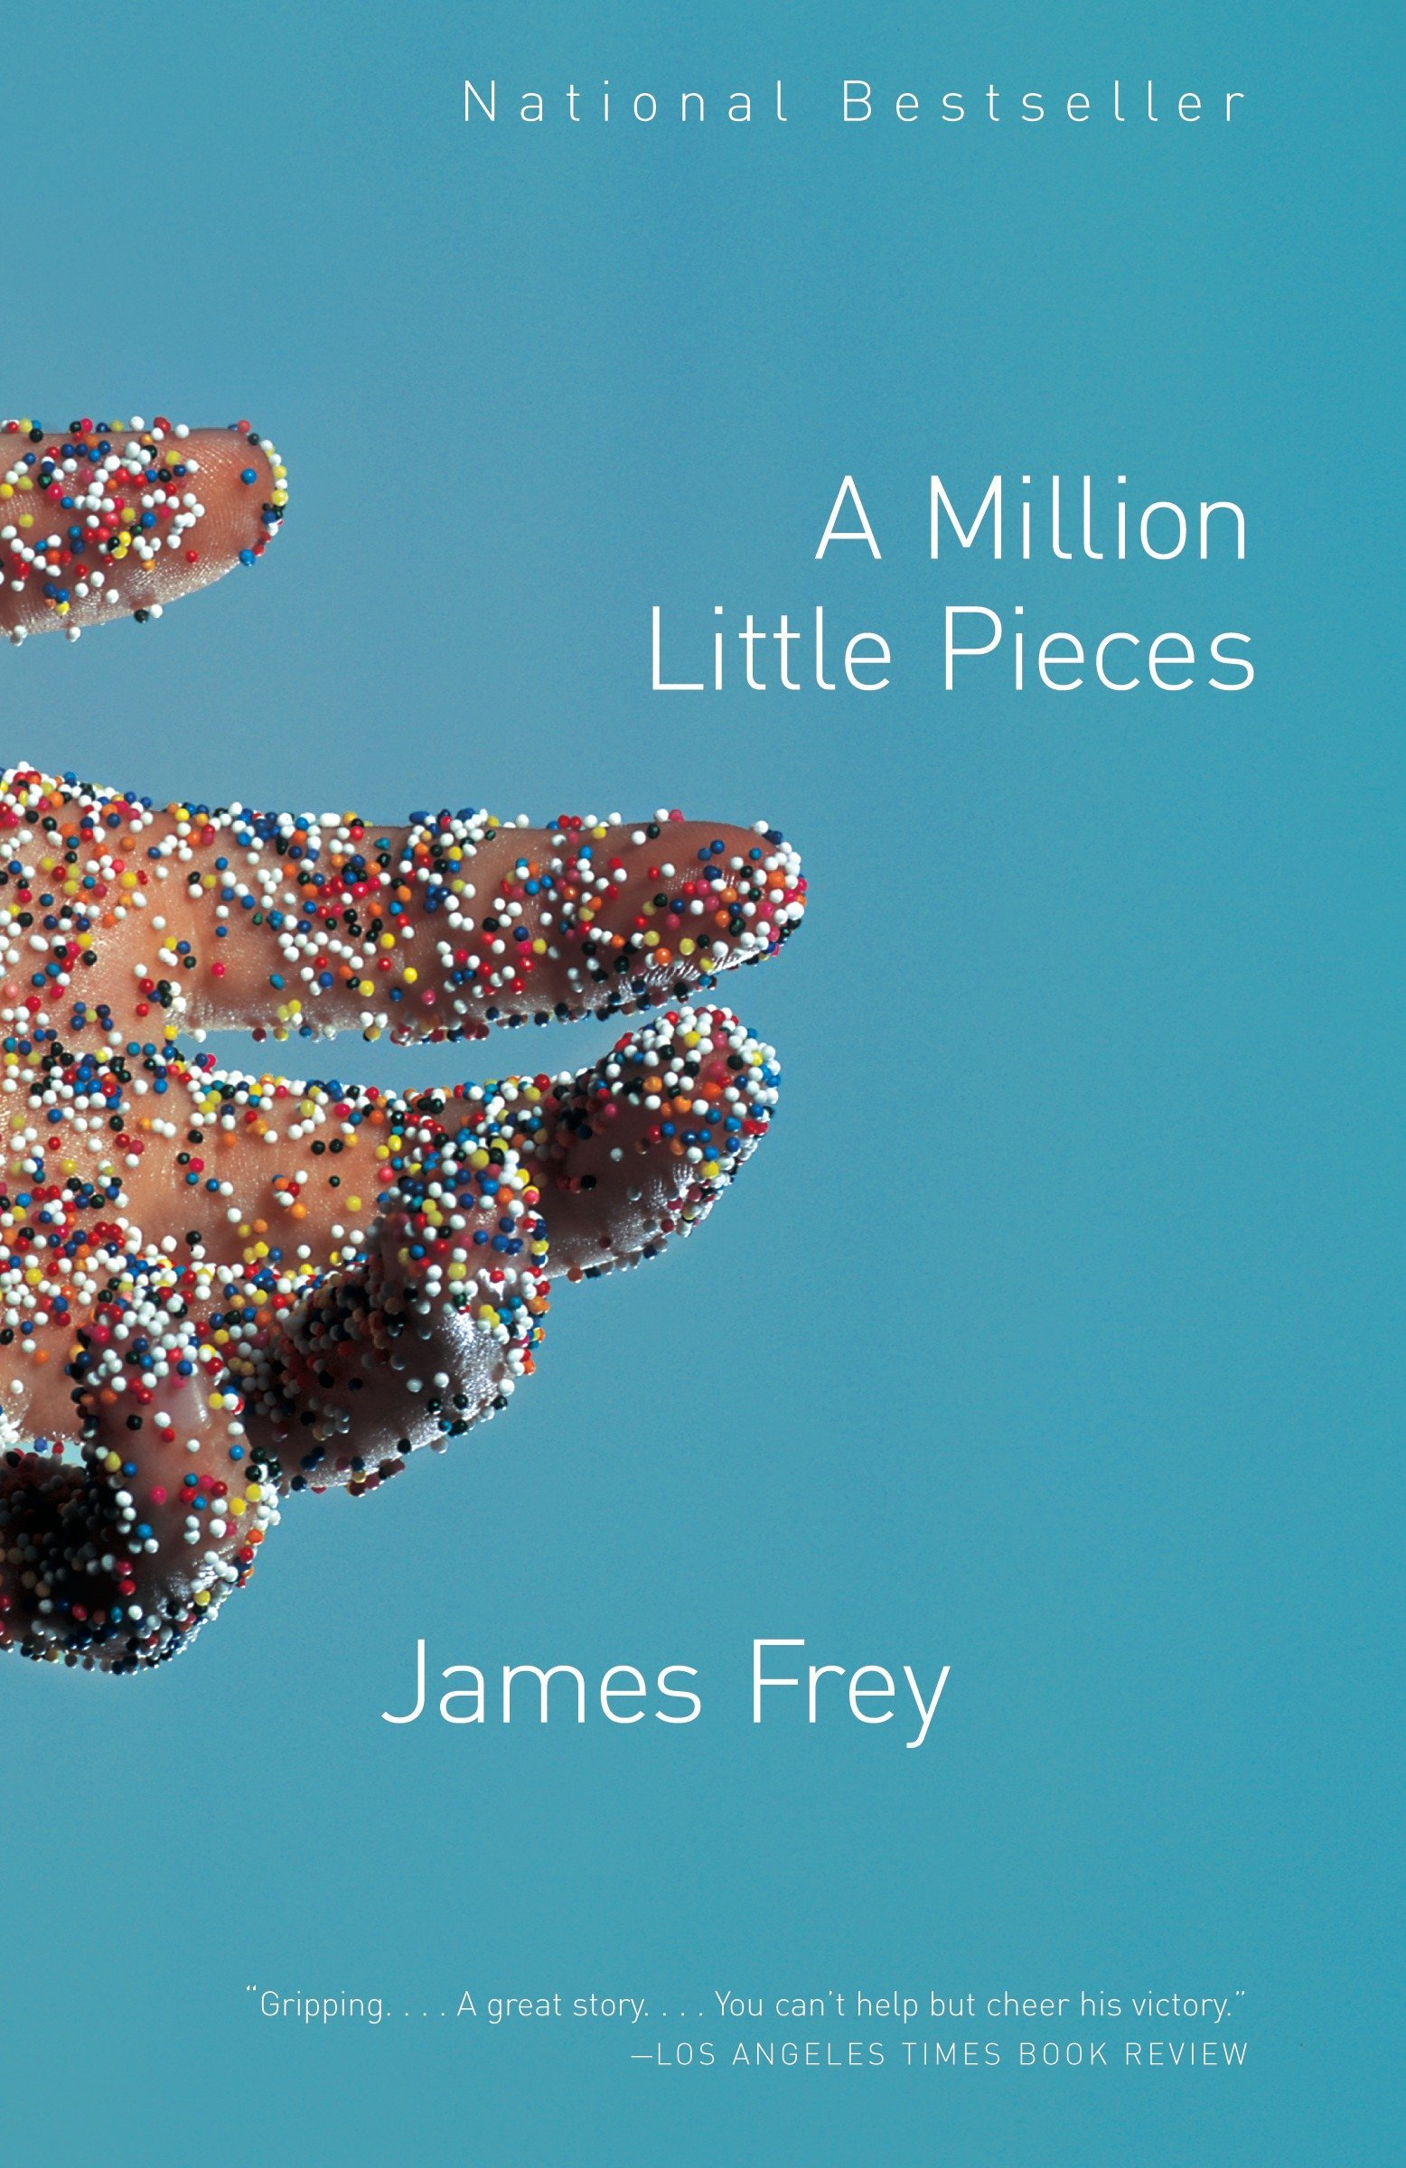
Read The Gardian’s ‘The Man Who Re-Wrote his Life’ and answer the following questions:
Do you think Fey did anything wrong? Why or why not?
Do you think Frey’s readers should be less inspired by his story now that they know it is actually fiction? Why or why not?

Slide 7
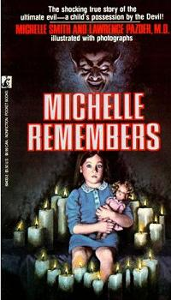
Michelle Remembers chronicles Pazder's therapy in the late 1970s with his long-time patient Smith.
In 1973 Pazder first started treating Smith at his private psychiatric practice in Victoria, British Columbia.
In 1976 when Pazder was treating Smith for depression, Smith confided she felt that she had something important to tell him, but could not remember what it was.
Pazder and Smith had a session where Smith screamed for 25 minutes non-stop and eventually started speaking in the voice of a five-year-old.

Slide 8
Over the next 14 months Pazder spent over 600 hours using hypnosis to help Smith recover alleged memories of satanic ritual abuse that occurred when she was five in 1954 and 1955 at the hands of her mother (Virginia Proby) and others, all of whom Smith said were members of a "satanic cult" in Victoria.

Slide 9
Over the next 14 months Pazder spent over 600 hours using hypnosis to help Smith recover alleged memories of satanic ritual abuse that occurred when she was five in 1954 and 1955 at the hands of her mother (Virginia Proby) and others, all of whom Smith said were members of a "satanic cult" in Victoria.

Slide 10
After numerous investigations into the legitimacy of Michelle’s claims, most investigations were left believing that many to most of her memories could not have taken place.
The author has argued that it is true for Michelle and that makes it real. However, we must explore every case and story with scepicism.
A 1995 book found further inconsistencies:
A car crash in the book was never reported on (even though the local papers reported on all crashes at the time.
The school had no record of any long absences, even though Michell claimed to have missed school for an 81 day ritual with the cult.

