Slide 1
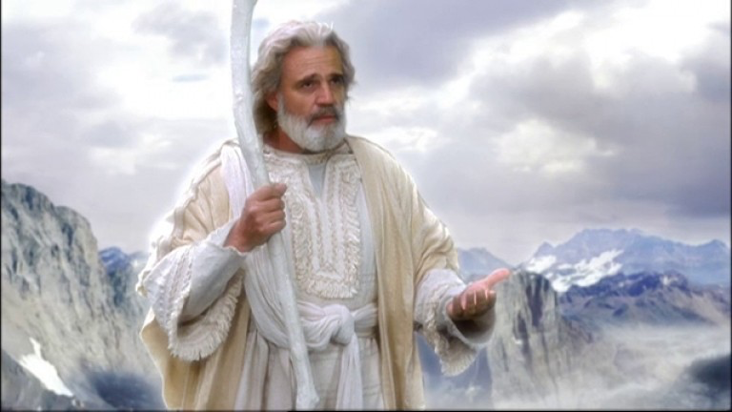
MYTHOLOGY

Slide 2
Why do we study mythology?
Represent the ideals of a certain time and place.
All of our hero qualities come from Greek Myths.
The structure of our stories come from myths.
Many of our monsters, symbols, and explanations of why the world is the way it is come from myths

Slide 3
What other reasons might we study mythology?

Slide 4
3 Types of Myths
Creation Myths:
How something was created of came to be.
Battle Myths:
Clash between good and evil or opposing sides, often result in an evil being released into the world.
Journey Myths:
Hero sets out to fix something wrong in his world (must leave home and always learns something in the process)

Slide 5
Creation Myths…
Some Similarities of creation myths:
World is created out of chaos/nothing/darkness
Either humans, animals, or nature created next depending on cultural values
Explain how nature came to be
What are some creation myths that we know?

Slide 6
Creation myths can usually be divided into these main categories
Creation by a supreme being (God etc.)
Creation through emergence (the inner power of Earth/ metamorphosis)
Creation by Earth Parents (a primordial mother and father)
Creation by the comic egg
Creation by Earth Divers (Earth exists but a diver (usually an animal) joins in and brings the Earth to its current state)

