Slide 1
First battle of the Marne
World War 1
By Misha, Ringo, Marco, Lena

Slide 2
General Informations
When? 5-12 September 1914, during the first year.
Where? On the River “Marne”, northern from Paris,France
Who? Allied Side: France (F.) and United Kingdom (UK.)
German Side: German Empire
Win? Allied Side.

Slide 3
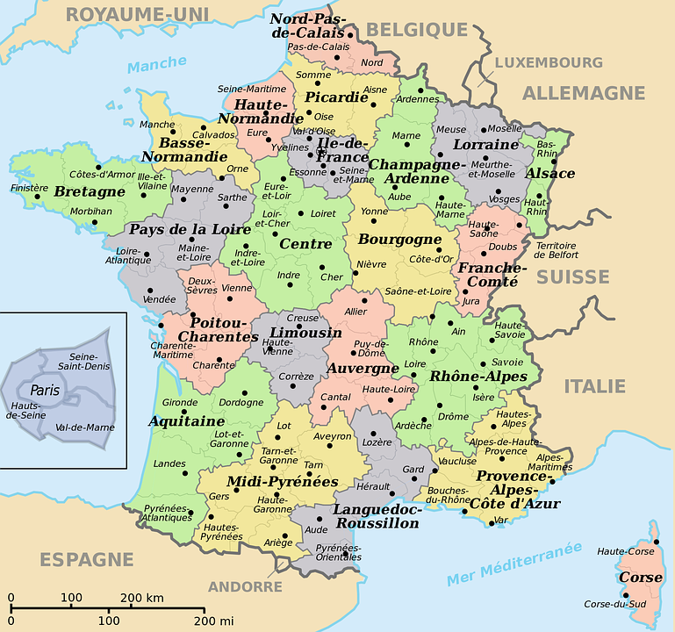
Location on the map

Slide 4
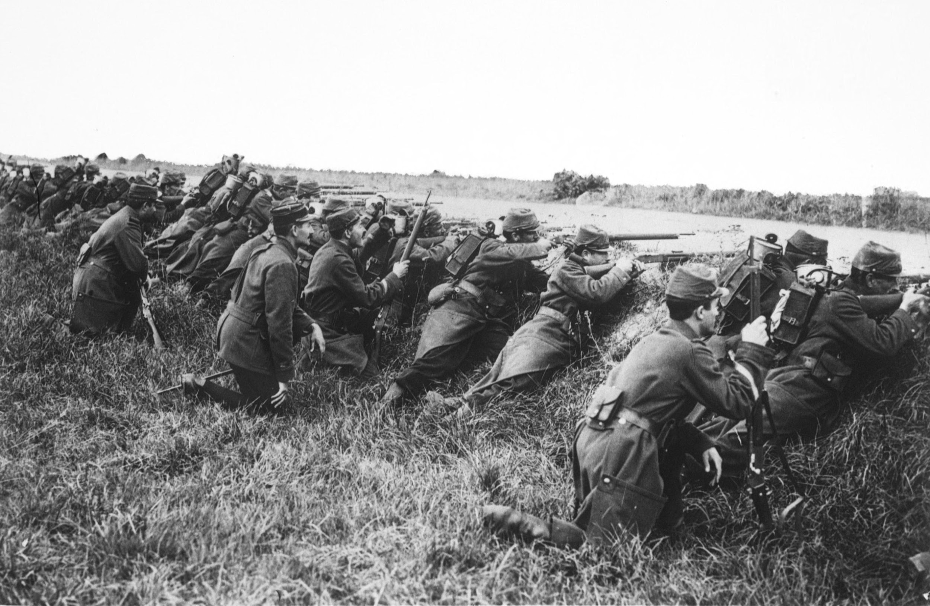

Slide 5
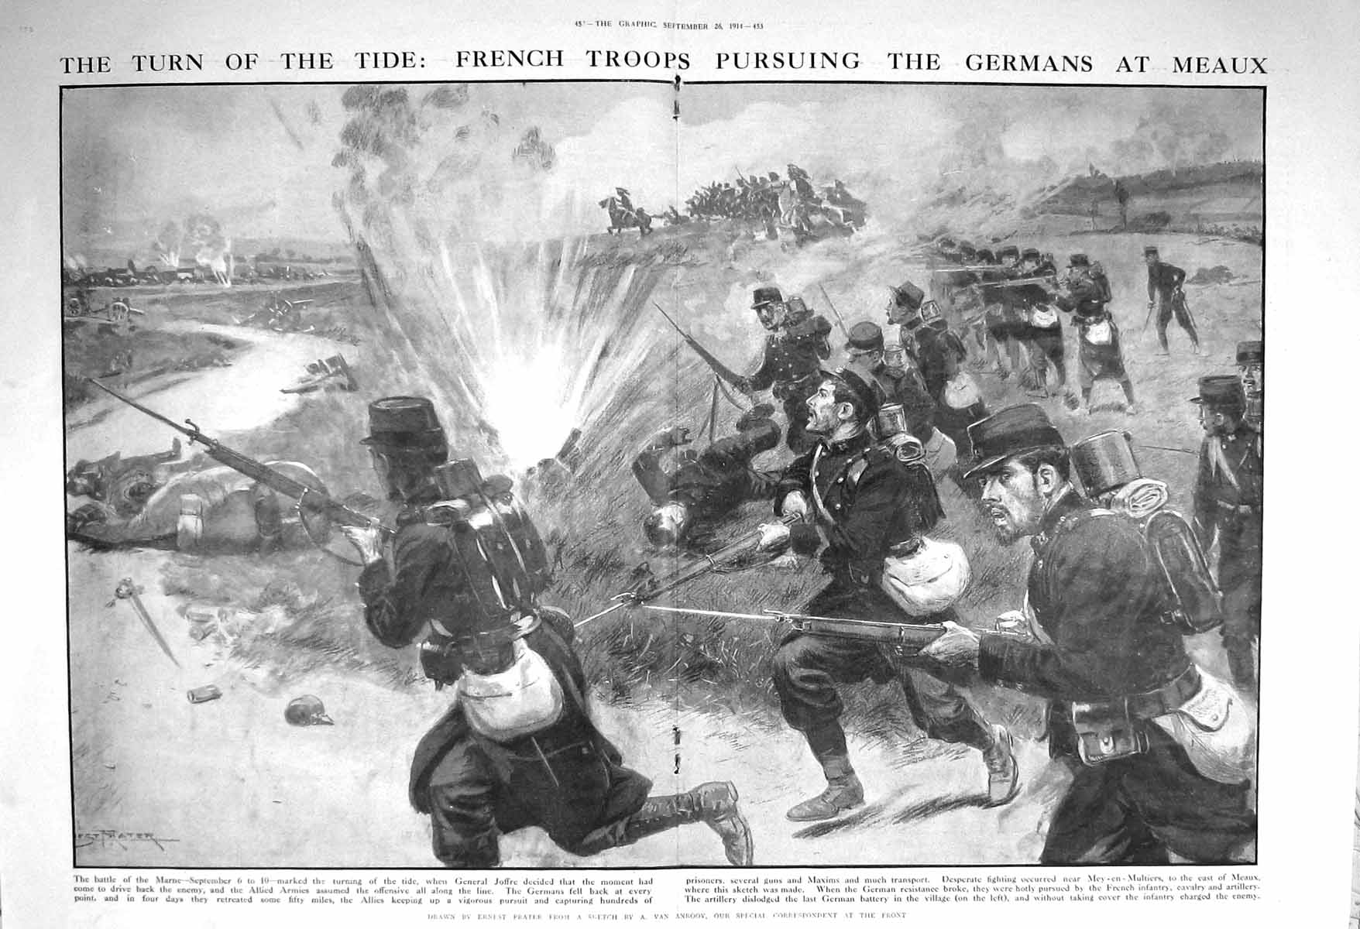

Slide 6
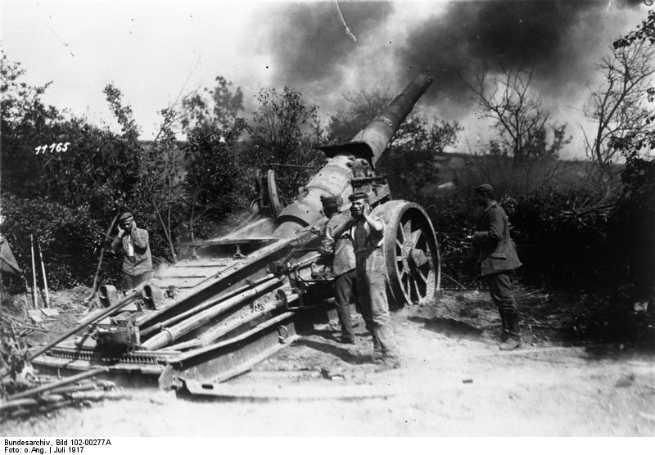

Slide 7
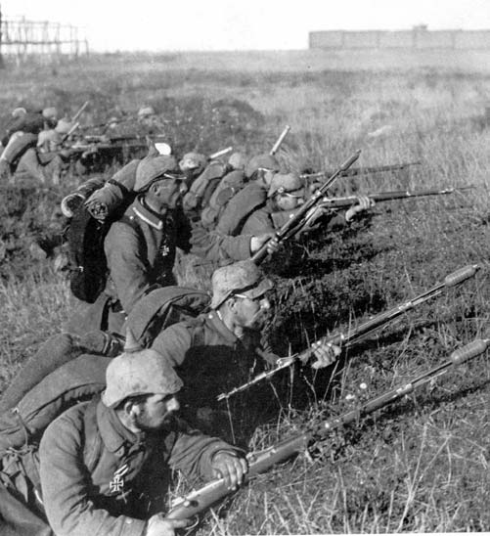

Slide 8
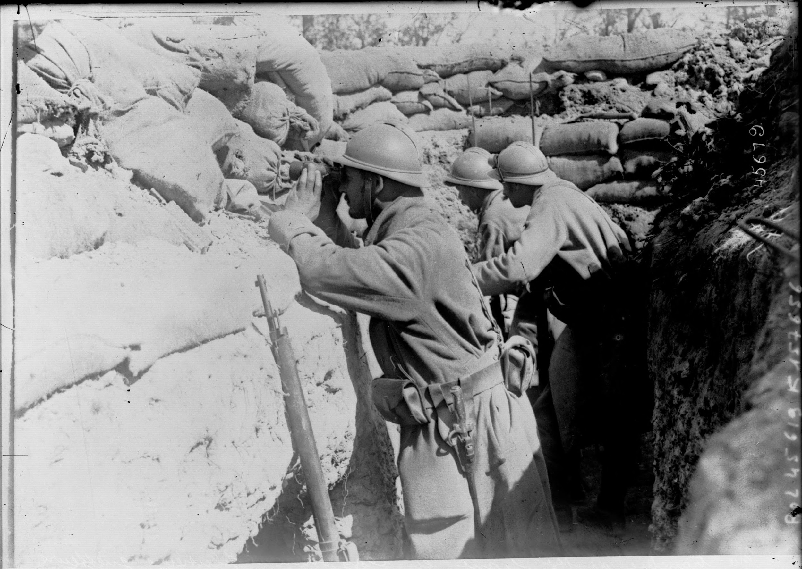

Slide 9
Outlines
Leading up to the battle:
-Germany’s Schlieffen Plan (conquer West-Europe, before Russia attacks from the east) -Allied side decided to give an all-out effort to stop the Germans (before they arrive at Paris)
The battle:
-German armies got split up and attacked from every side. They got confused and forced to retreat.
-Back to Aisne river. Hold off the allied army with trenches for the next four years.

Slide 10
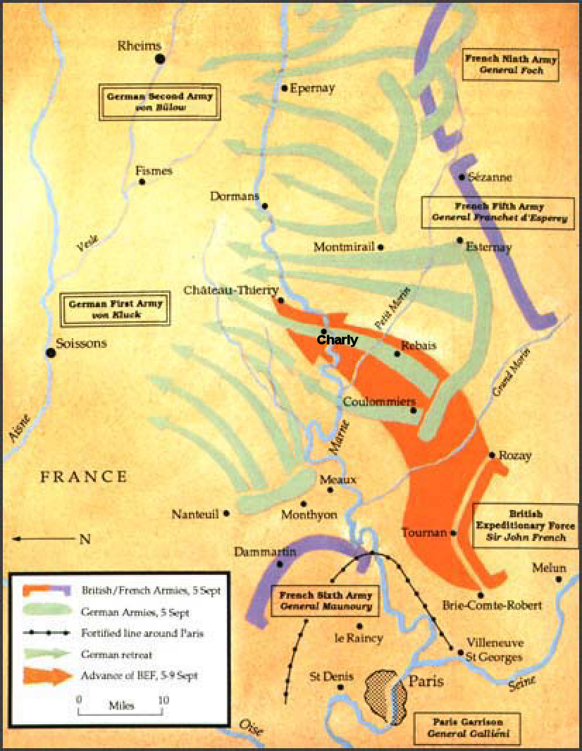

Slide 11
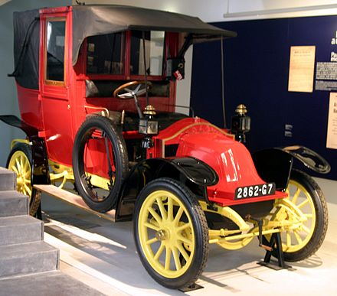
Significance events
1.Use of taxis helped move troops faster
at the battlefield
2. Reconnaissance planes were used to discover
enemy military positions

Slide 12
Reasons for success (Allied side, F.,UK)
-Still attacked even though the french general said his army is to tired.
-The first and second armies from Germany got split up
-They attacked Germany from every side they couldn’t concentrate on one side
-Russia started to attack from the east Germany had to fight at two fronts

Slide 13
Reasons for failure (German side)
-Germany expanded their territory further out
- They had to defend more and more ground with fewer troops
-They became more vulnerable
-The French troops knew their country and could rely on that knowledge, the germans simply didn’t.
-Had to fight at two fronts so they got fewer soldiers at the west front.

Slide 14
Significance of the battle overall
-Changed the whole war
-Determinative for failure of Germany overall
-Schlieffen plan doesn’t work anymore
-Ending of mobile warfare, start of static warfare on the western front

Slide 15
Highlight of Canada’s contribution
No canadians fought in that battle.
Reasons: -war started about a month before that battle
-Canada first got involved in January 1915
Notes:
I think not involved

Slide 16
Costs
x | Allied Side | German Side | Overall
Included soldiers and prisoners | More than 1.000.000 | A little more than 750.000 | More than 1.750.000
Lost | F: 250.000 | 222.000
 | UK: 12.700 |  | 484.700
Costs for material | Great cost | 30 guns 100+ machine guns | Great cost

Slide 17
Sources
http://www.lexikon-erster-weltkrieg.de/Erste_Schlacht_an_der_Marne
Allbuch
http://www.sueddeutsche.de/politik/erster-weltkrieg-morden-an-der-marne-1.2115792
http://www.ducksters.com/history/world_war_i/first_battle_of_the_marne.php
http://www.mta.ca/library/courage/canadasroleinwwi.html
http://www.firstworldwar.com/video/taxisofthemarne.htm
http://www.mapsofworld.com/world-war-i/first-battle-of-marne.html

