Slide 1
Egyptian Food
By Elizabeth and Shalom

Slide 2
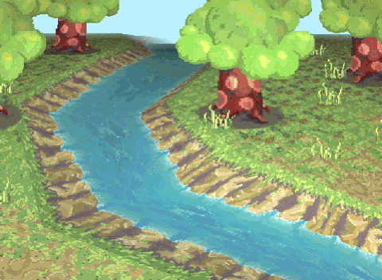
Growing Food in Ancient Egypt
The Nile River proved to be a fruitful location for growing crops due to the annual flooding of the Nile.
After a flood, silt and mud spread throughout the near proximity of the river, creating optimal soil for growing food.
Most frequently grown from this fertile soil was wheat and barley.
Grain was the most important crop to grow, due to its versatility.

Slide 3
Ancient Egyptian Date Balls
Ingredient
1/3 cup apple juice
1 package (8 ounces) chopped dates
1 cup finely chopped pecans, toasted
1-1/4 teaspoons ground cinnamon
1/4 teaspoon ground nutmeg
1 cup ground almonds, toasted
Directions: In a microwave, warm apple juice. Stir in dates; let stand 5 minutes to soften, stirring occasionally. Remove dates from apple juice; discard liquid. Transfer dates to the bowl of a food processor fitted with the blade attachment; process until smooth. Add pecans and spices; pulse just until combined (mixture will be thick).
Shape mixture into 1-in. balls; place on a waxed paper-lined baking sheet. Refrigerate, covered, 30-60 minutes.
Roll date balls in almonds
To toast nuts, bake in a shallow pan in a 350° oven for 5-10 minutes or cook in a skillet over low heat until lightly browned, stirring occasionally

Slide 4
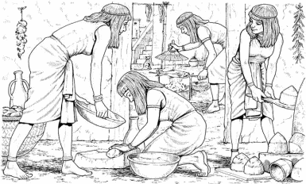
The Poor
Main food eaten by both rich and poor was bread
Barley was used to make beer sweetened with dates and honey
The main reason they drank beer was because fresh water was hard to come by
Poor egyptians only ate meat on a special occasion
Ate fish and poultry more often.
Notes:
First the grain was made into flour. It was then made into dough with water and yeast which was placed into a clay mould before being cooked in a stone oven.
The beer was made with barley that was previously bread and soaked in hot water.

Slide 5
The rich
food of the rich included meat – (beef, goat, fish from the Nile (perch, catfish, mullet) or poultry (goose, pigeon, duck, heron, crane) on a daily basis.
Meat, fish and poultry was roasted or boiled. It was flavoured with salt, pepper, cumin, coriander, sesame, dill and fennel.
Meat, fish and poultry that was not eaten quickly was preserved by salting or drying.
A variety of vegetables were grown and eaten by the ancient Egyptians including onions, leeks, garlic, beans, lettuce, lentils, cabbages, radishes and turnips.
Fruit including dates, figs, plums and melons were eaten for dessert

Slide 6
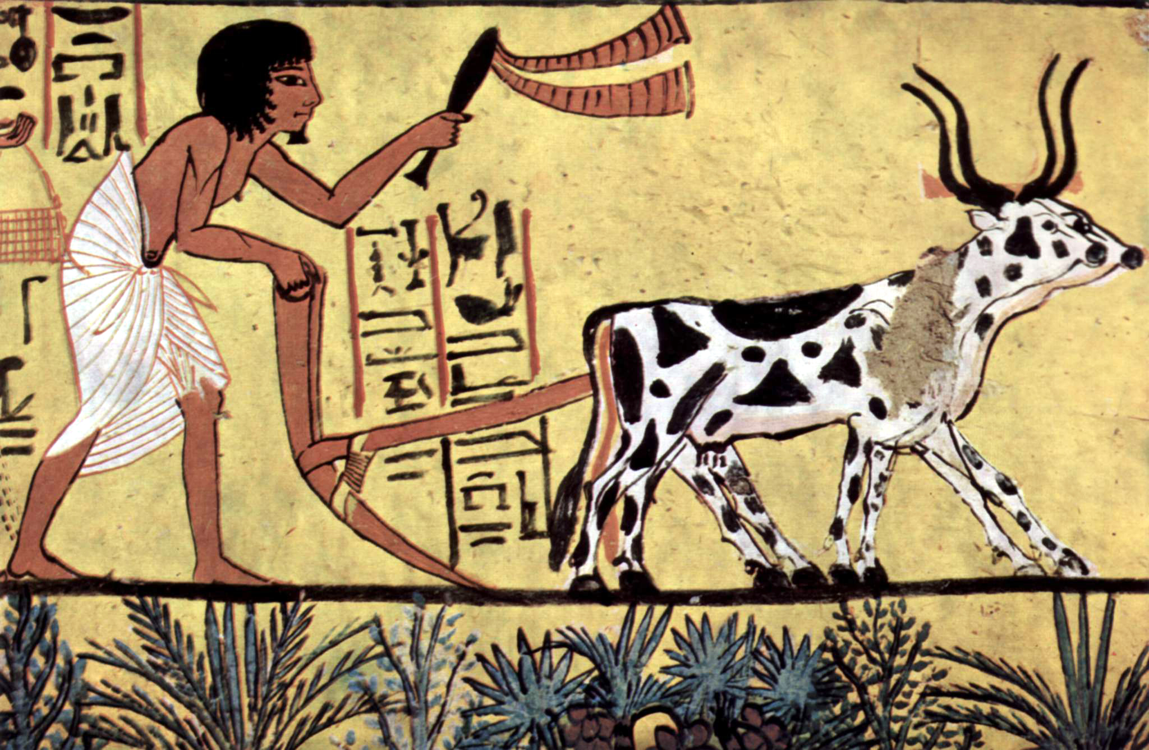
Farmers
The people of ancient Egypt grew everything they needed to eat.
The pharaoh got the rich peasants to do the farm work on the rich lands.
Most villagers were farmers. Farmers lived in towns too, along with craftworkers, traders and other workers and their families
Egyptians grew crops such as wheat, barley, vegetables, figs, melons, pomegranates and vines. They also grew flax which was made into linen.
The most important crop was grain which was used to make bread, porridge and beer

Slide 7
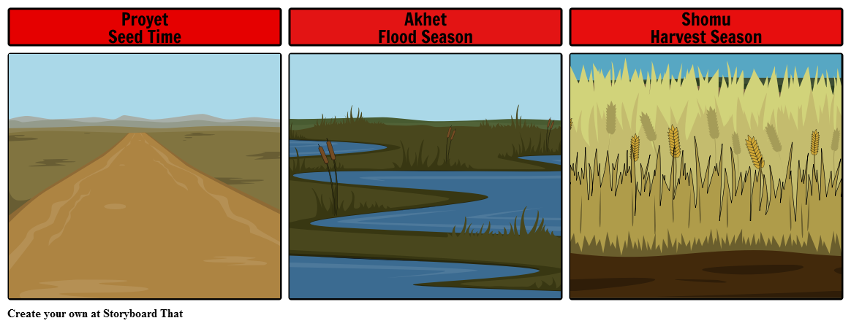
Seasons of Egypt
Seasons are important in regards to growing crops
Akhut, June-September (The inundation) - This is flooding season many farmers worked for the Pharaoh, building pyramids during this time,
Peret, October-February (The growing season) This was when the water had drawn back and the fertile soil was left to be planted in
Shemu, March-May (The harvesting season) Crops were cut down and harvested.
Notes:
Contrary to our modern season system there is only three seasons

Slide 8
THANK YOU
https://www.historyonthenet.com/ancient-egyptian-food
http://www.primaryhomeworkhelp.co.uk/egypt/farming.htm

