Slide 1
Ancient China
One of the longest, continuous cultures in the world
Notes:
The oldest artifacts in this region are dated more than 6000 years old, which makes China unique in being a long-running, sustained civilization in the same geographical location, and more or less, the same language existing throughout.

Slide 2
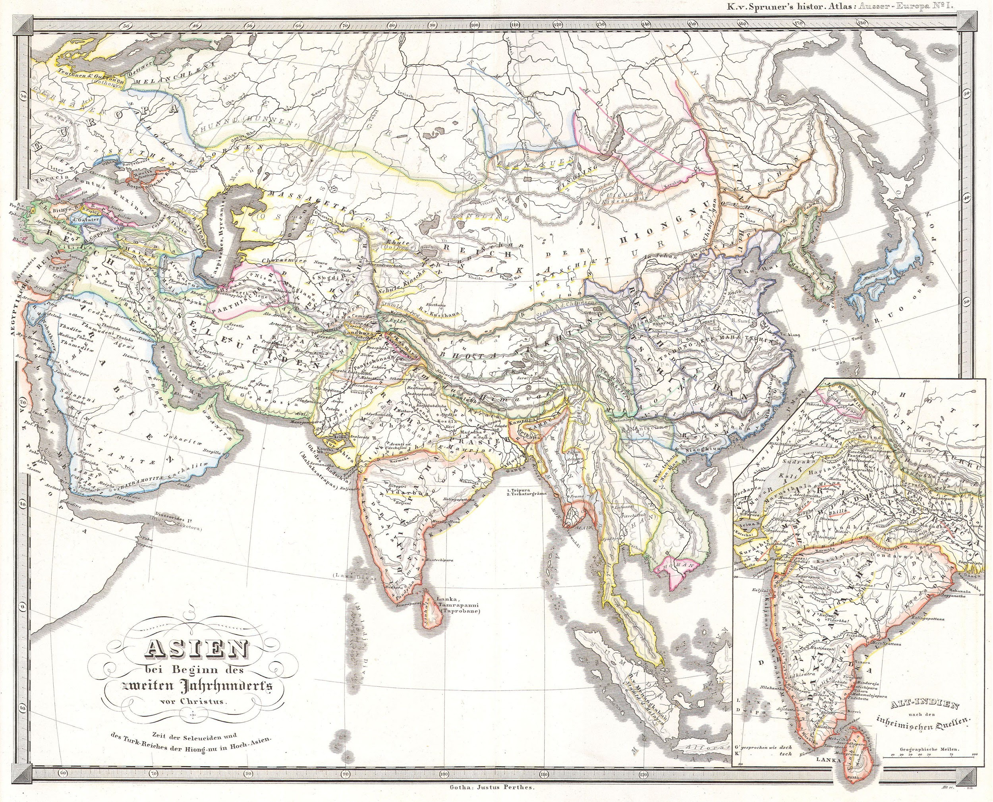
The Middle Kingdom
The Chinese Han people called themselves “The Middle Kingdom” acknowledging that there were other people in all directions except East (where the Pacific Ocean lies).
Notes:
Ancient rulers of China recognized that Mongols had territory to the north, India and many small kingdoms existed in Southeast Asia, and that to the West there were nomadic tribes. They simultaneously asserted that China was the dominant great culture, and that all these other ethnic groups were inferior to them in culture and geography.

Slide 3
Relationships with “Barbarians”
The Chinese philosophy that claimed they were superior to neighbouring cultures has been in place for millennia. Their reasoning is that everything one could ever need was found in China: arable land, rivers, a diverse range of flora and fauna, strong people, a beautiful written language, a long history of arts, music, dance, religion and more. It was a compelling argument.
Neighbouring countries had shown their inability to compete with China, and inability to conquer, so the best they could hope for was a peaceful trade relationship. China called these “tributary states” and these 5 or 6 countries would annually pay China money and gifts to keep a friendly relationship.
Notes:
Tribute = money to ensure continuing peace with a more powerful neighbour. In some eras, the Chinese also kept the provinces loyal and obedient by “ransoming” the local lords’ eldest sons to live in the capital with the king, to “learn diplomacy and good government”

Slide 4
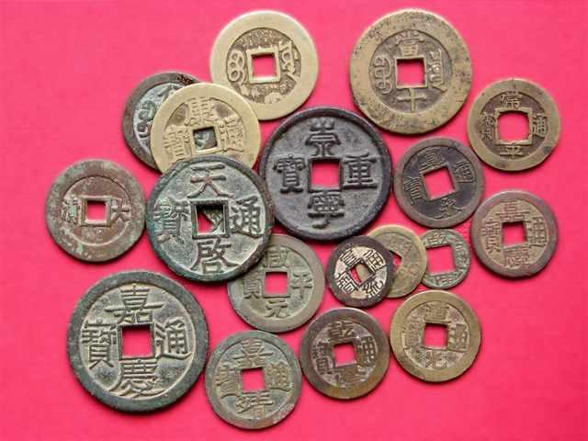
The Chinese crafted early coins but invented paper money.
Classical bronze coins - have a hole in the middle to be strung on a cord, and worn around the neck.

Slide 5
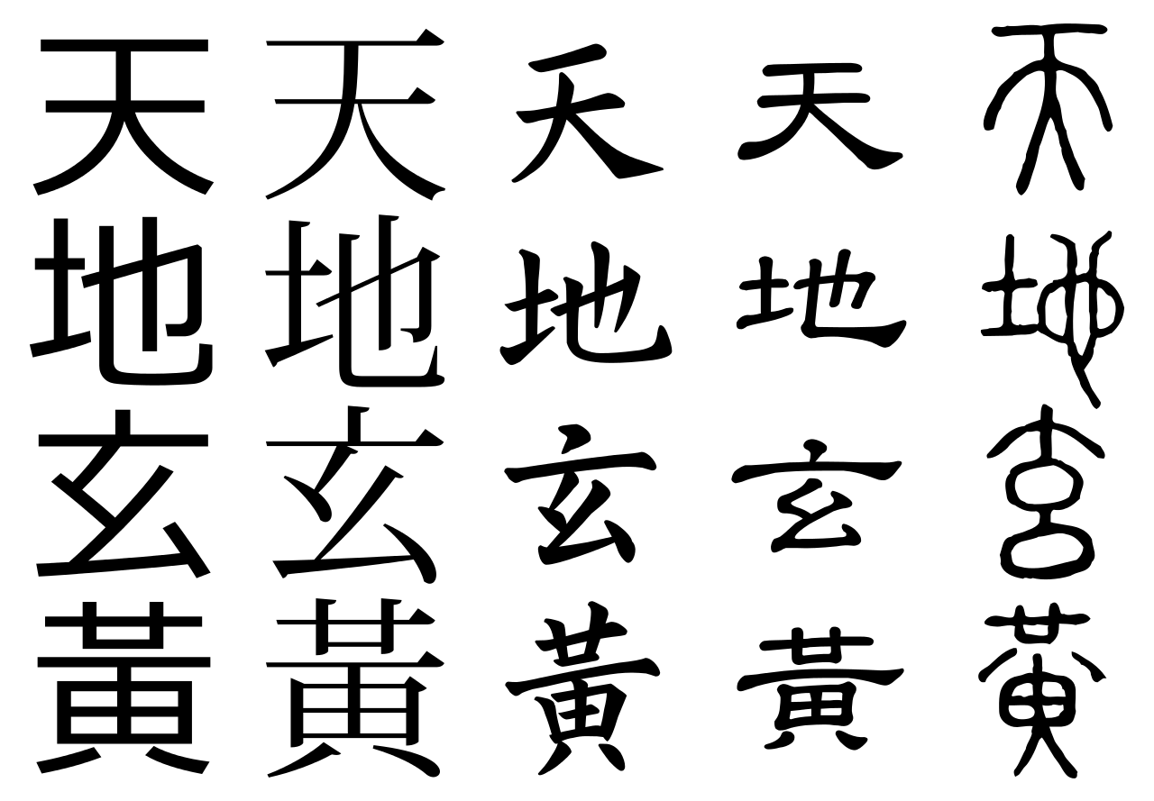
Chinese characters - lasting language
Chinese writing has lasted for millenia. Korea and Japan adapted the Chinese script into their own versions. In China there are are over 30 dialects spoken in China and many Chinese cannot understand each other verbally, but typically the written language is a link that all can comprehend.
Notes:
The Chinese mastery of a written language is one of their greatest claims to superiority. This does not suggest that everyone was literate - far from it, but the fact that all government officials had to master writing, reading, creating poetry and understanding ancient texts, indicates that literacy was a priority from early times.

Slide 6
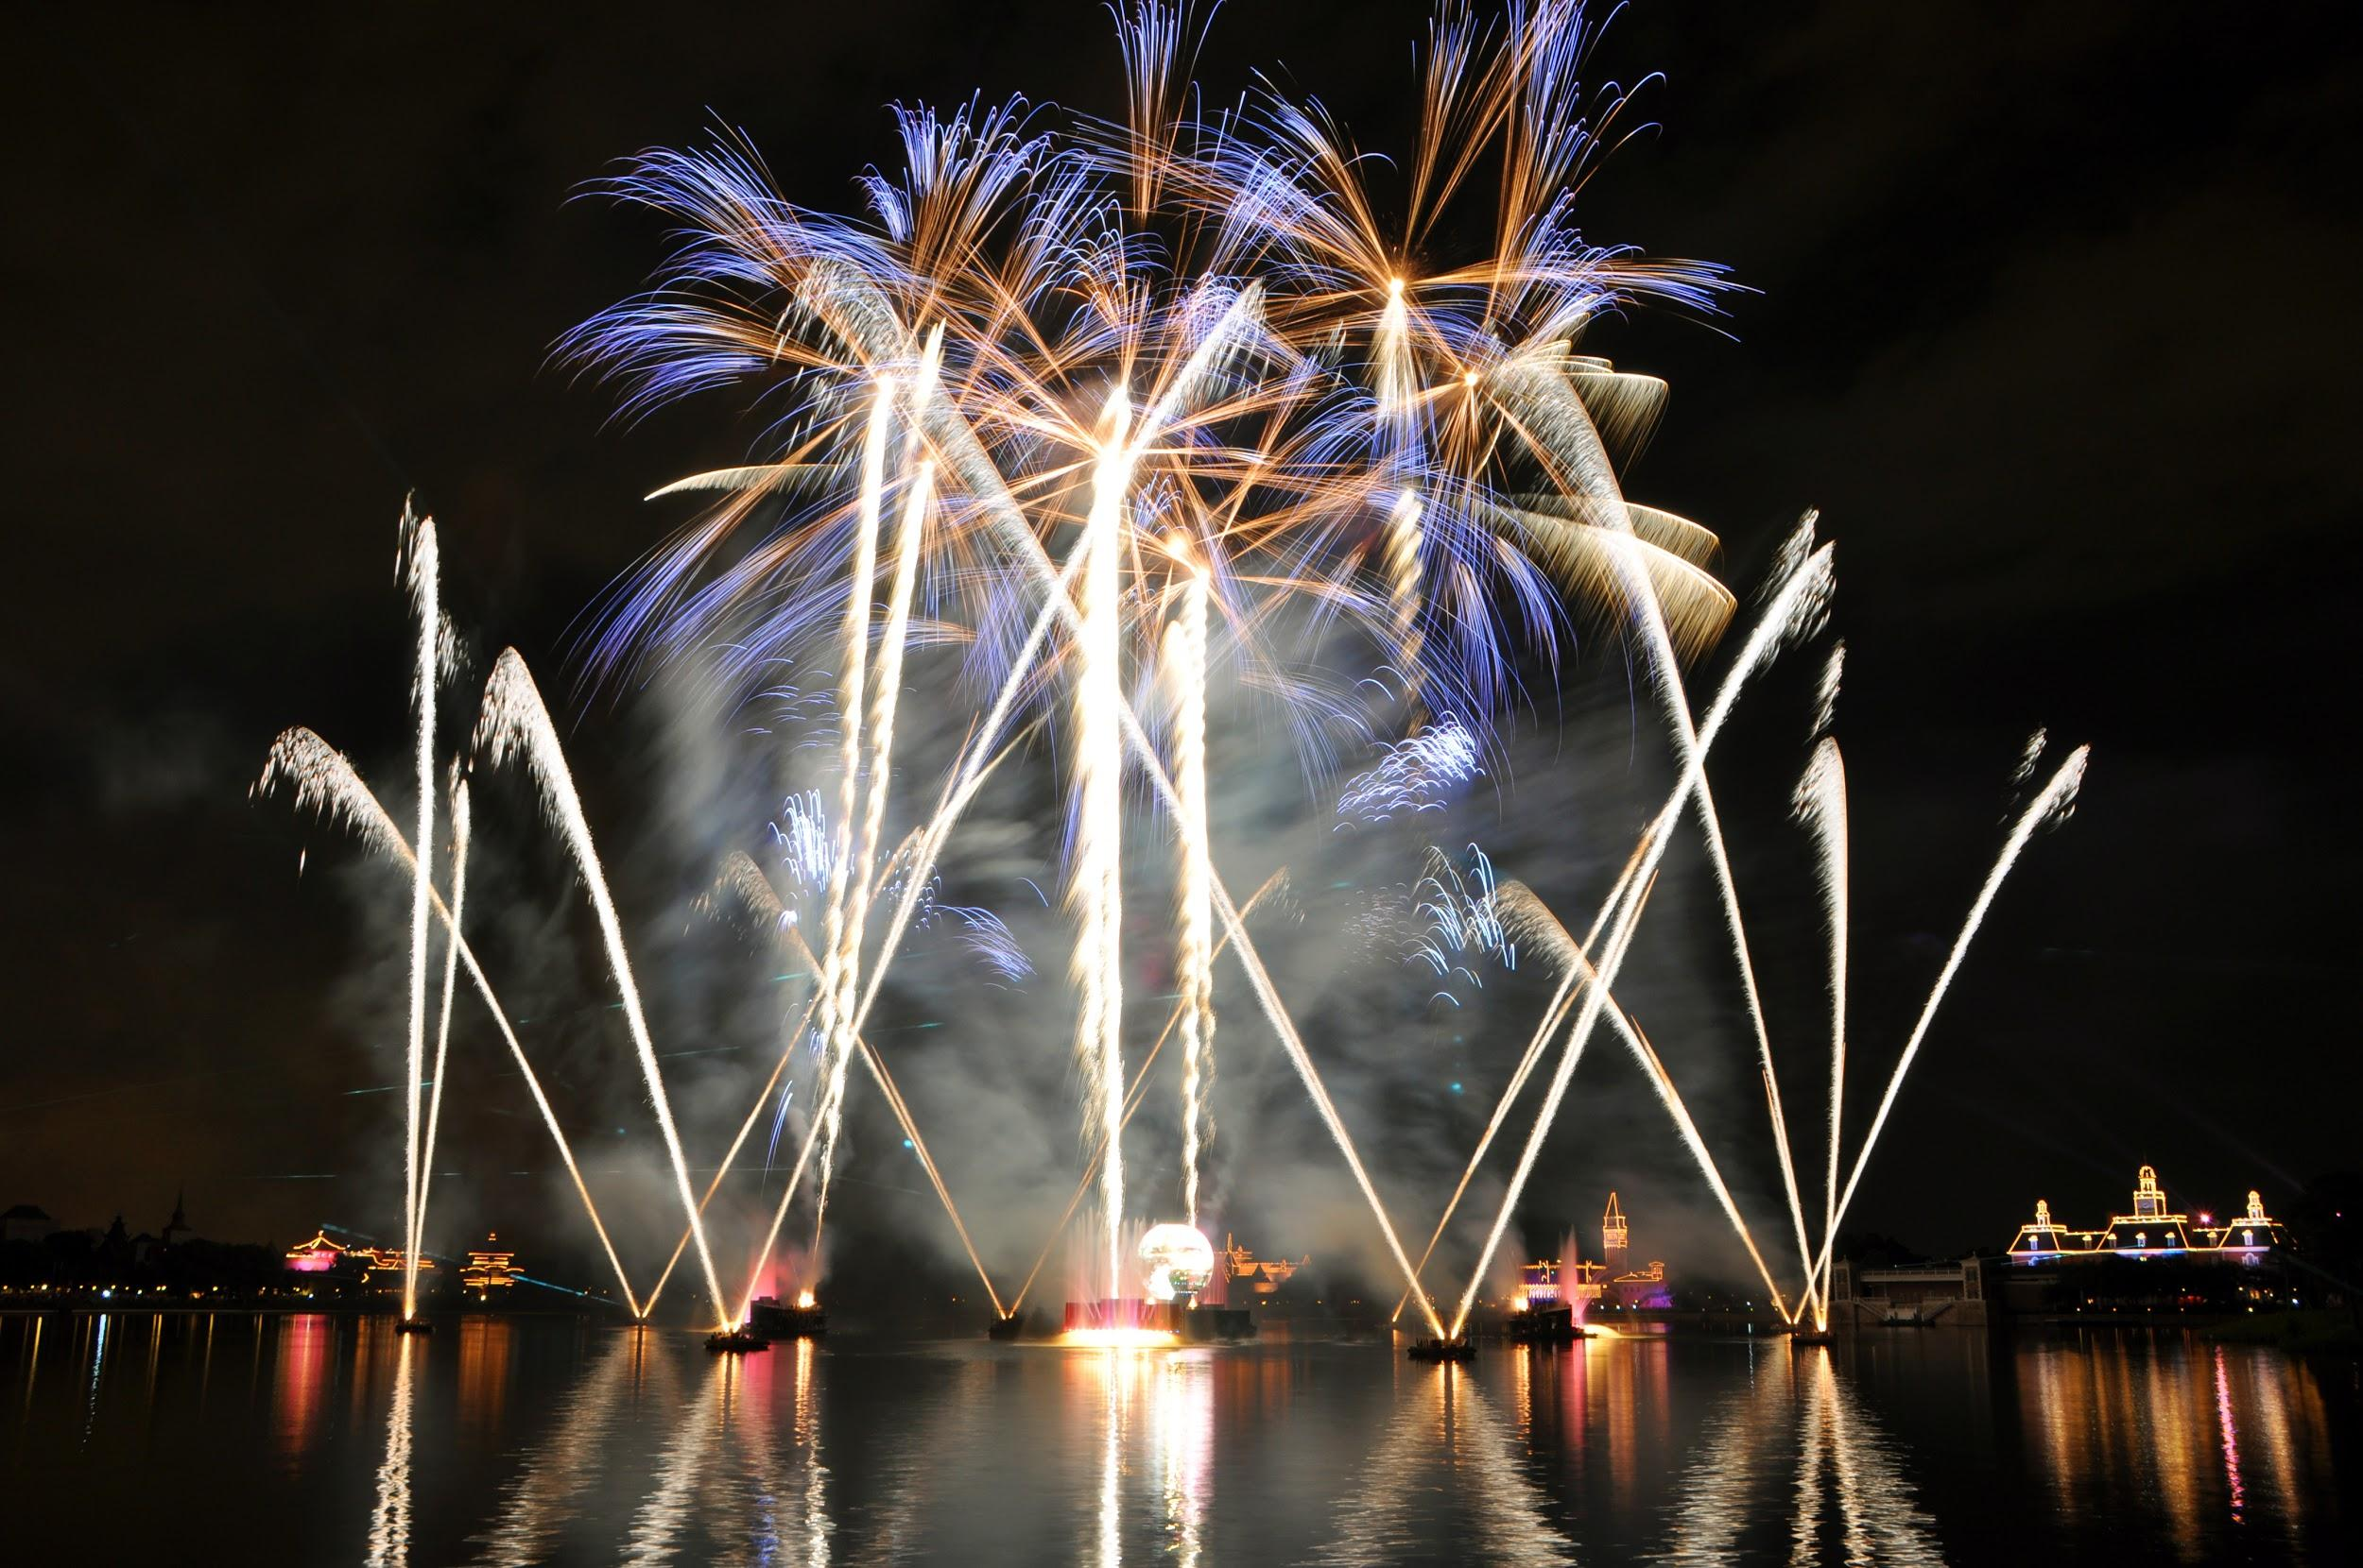
Hundreds of dynasties, dozens of inventions.
Gunpowder, cannons, noodles, stirrups, armour, the Great Wall, herbal medicine, metallurgy and more!

Slide 7
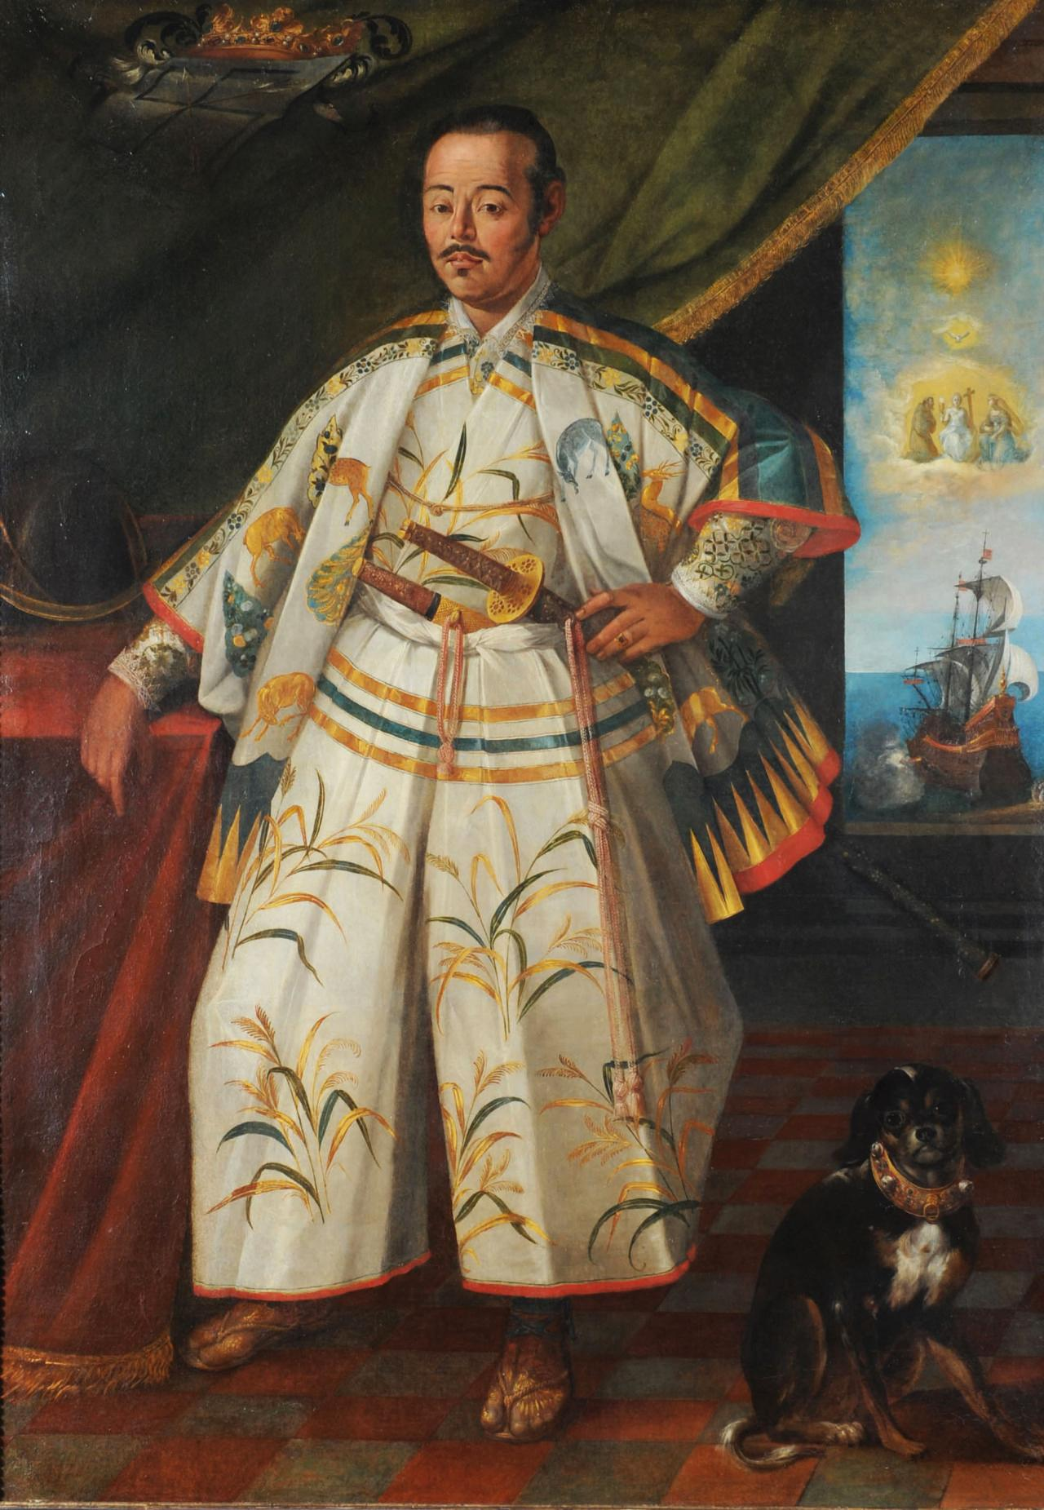
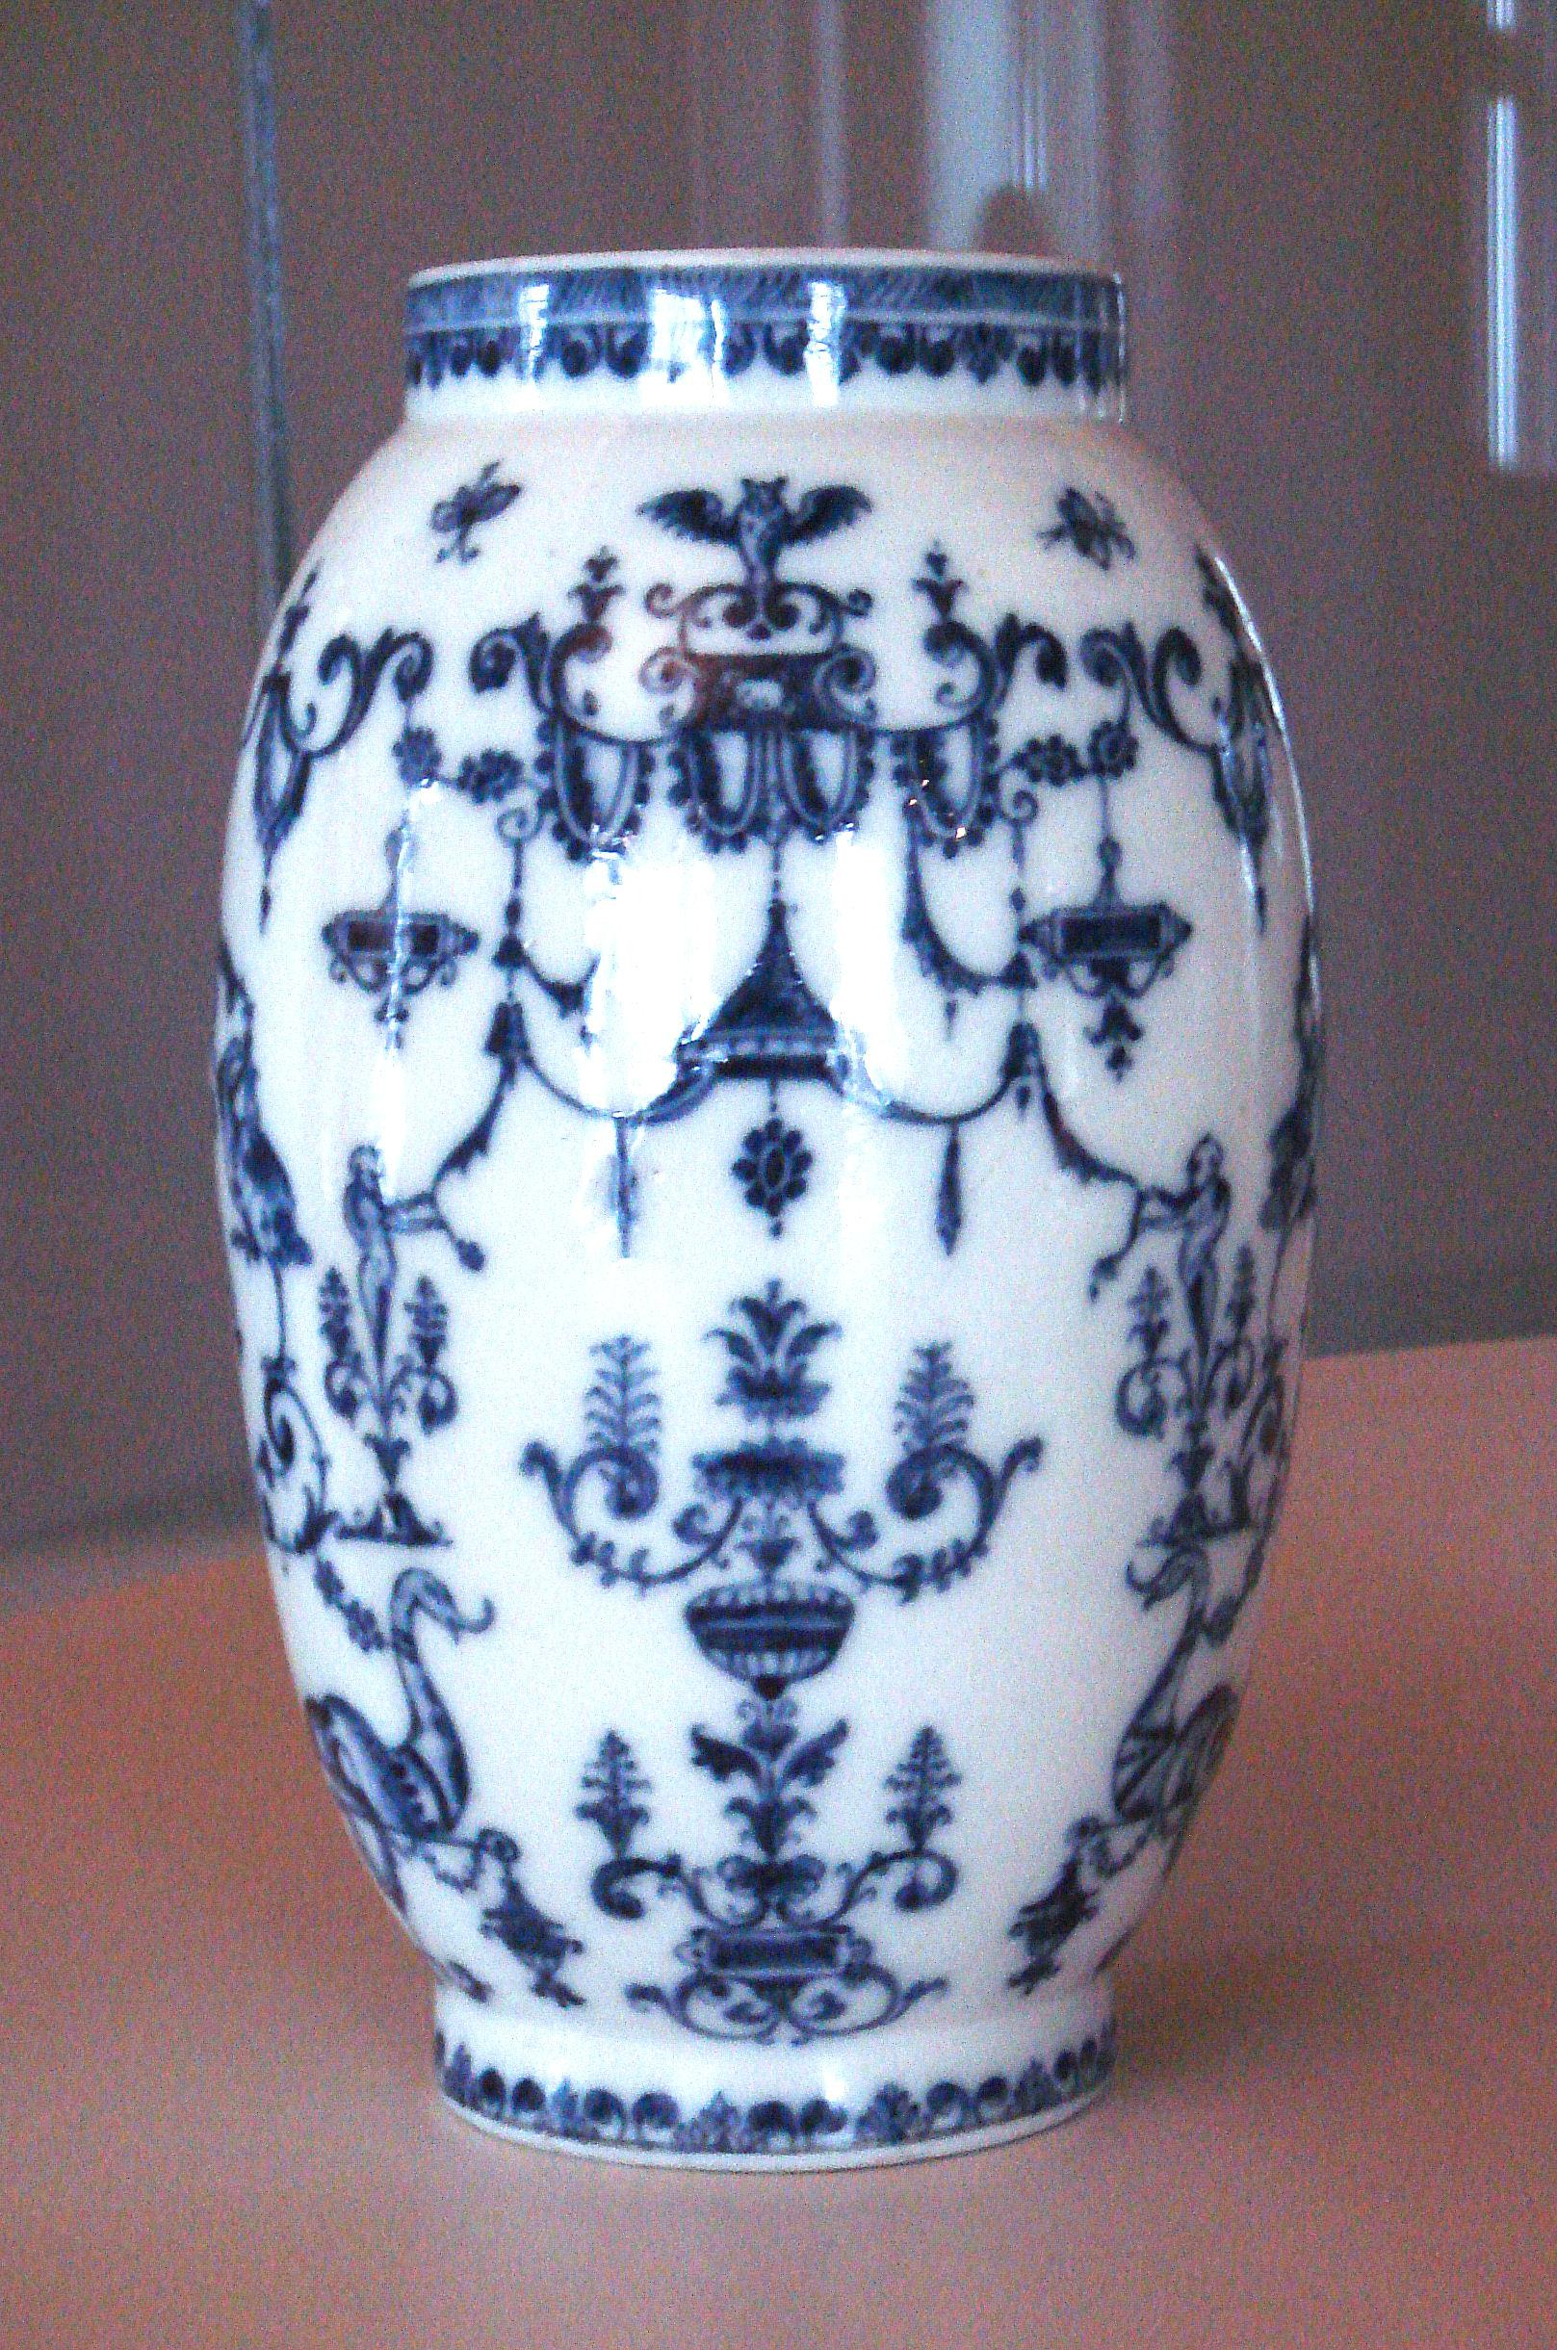
Silks, spices, and exotic goods
Academics felt trade was somehow distasteful and inferior. The rest of society realized that merchants and craftsmen were essential to the wealth of the land. How to make the products that drew the most profit from trade were considered secrets: Techniques to make silk and porcelain were carefully guarded so that foreigners could not reproduce these for themselves.

Slide 8
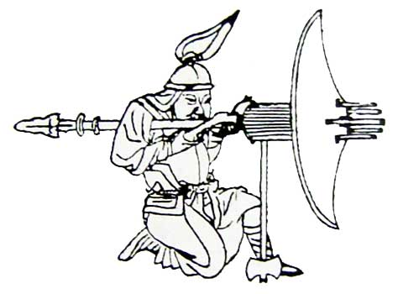
Warfare in Ancient China
China boasted an ability to defend herself from the early Bronze Age onwards. Many internal conflicts troubled the population and caused severe hardship, but not invasions from outside, until the Mongol Invasion in the 1200s. In most ancient dynasties there was a relatively small standing army, and other men in society were expected to contribute in times of war.
Chinese weaponry was something to be admired and envied.

Slide 9
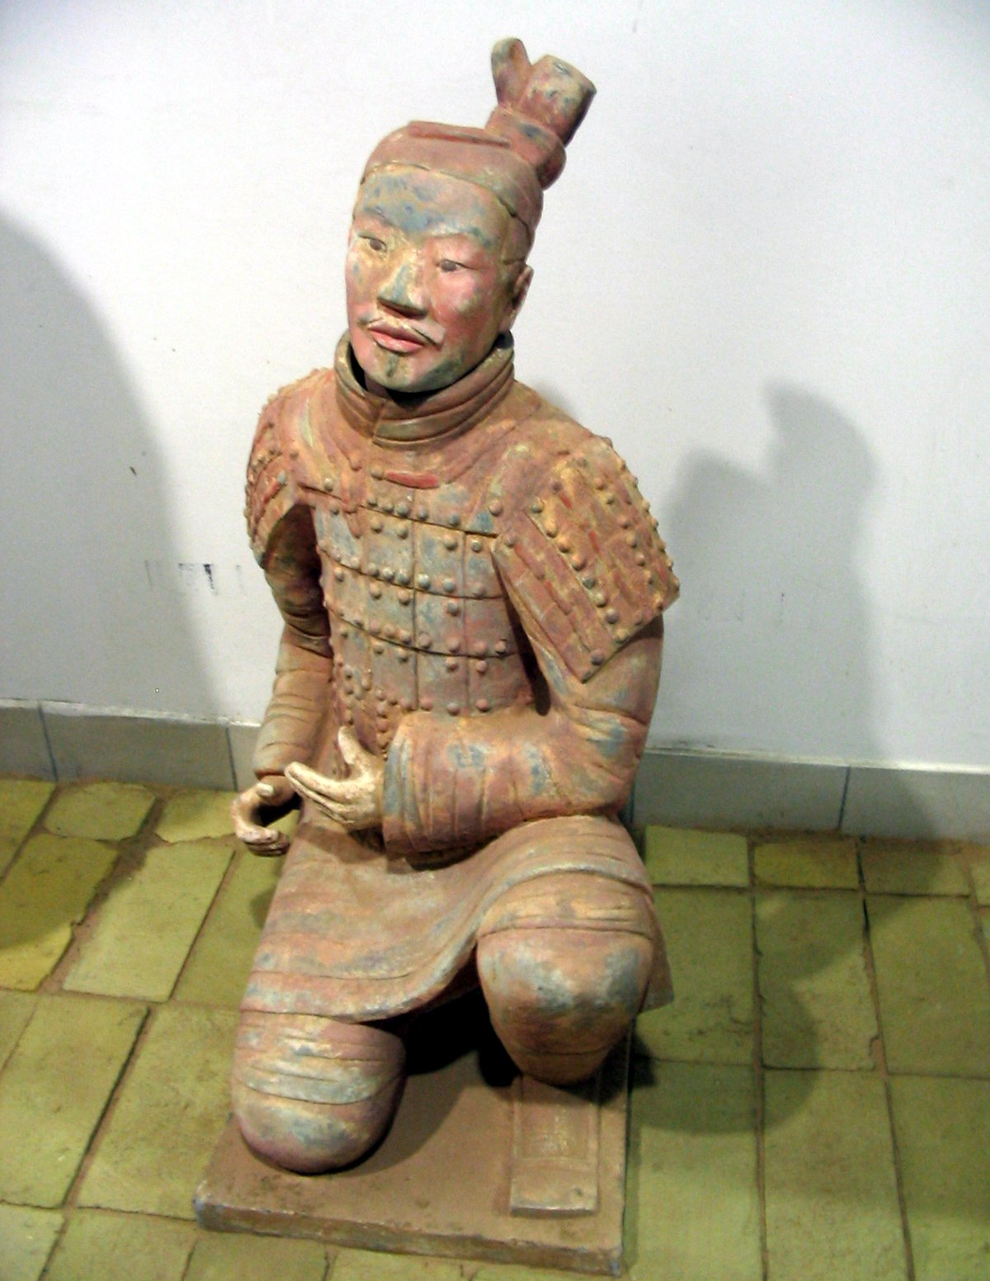
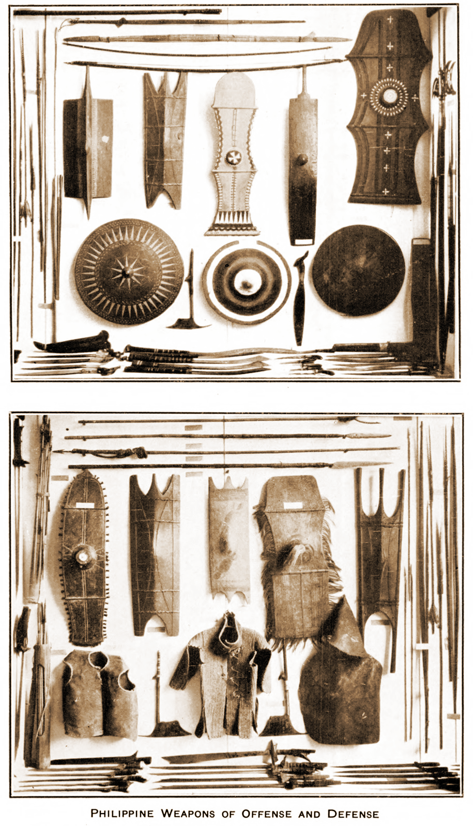
Armour, swords, and spears
The earliest armour was fashioned out of layers of leather. Then it was embedded with pieces of metal. Finally, an early version of chain-mail was developed.
Notes:
Chinese artisans mastered the skill of forging alloys and metals in the early 1500s BCE.

Slide 10
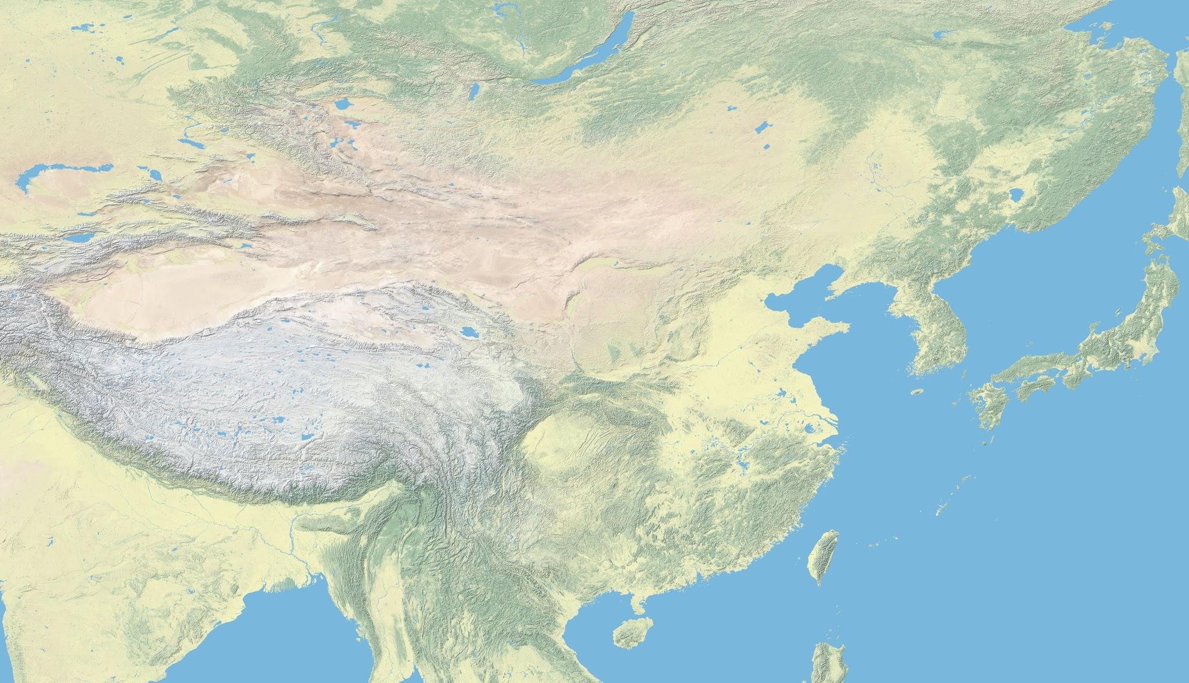
Travel by sea? Not interested
One notable activity engaged by other powerful coastal empires in ancient times, was not a priority to the Chinese. They forbade foreigners from arriving on their eastern coast for many centuries and most dynasties did not engage in exploration of land overseas. The Chinese adamantly rejected arguments that they should reach out to the surrounding islands. Japan was allegedly colonized by rebels who left China in the 6th century BCE

